Slide 1


Personal Use of Social Media
Department of Housing, Local Government and Community Development
Elected Member Training
Learning and Development
Local Government and Community Development

Slide 2

Course Overview:
What is social media?
What is public and what is private?
Receiving community comments or questions
How to manage on-line bullying
Social media DOs and DON’Ts
Notes:
This presentation is to assist local government council members to understand their obligations when using social media. Further information, including frequently asked questions, can be found in the ‘Personal use of social media’ fact sheet prepared by the Department of Housing, Local Government and Community Development.

Slide 3

1. Introduction
Social media presents opportunities to interact, engage and share information.
However, how you use social media in your personal life can impact your work and your council.
As an elected council member, you have an important role to play in maintaining public trust and confidence in your council.
This role is influenced by how you use social media.

Slide 4
2. What is social media?
Social media is made up of tools and platforms such as websites and apps that allow users to connect, create and share content.
Social media may include:
Social networks like Facebook, X and LinkedIn
Media sharing networks like YouTube, TikTok, Instagram and Snapchat
Discussion forums such as Reddit and Whirlpool
Sharing websites like Gumtree and Uber
Notes:
Social media is a powerful communication and networking tool that has become part of our everyday life.
The term ‘post’ refers to any shared or created content put on social media.

Slide 5

3. Why the focus on social media?
Our responsibilities as elected council members apply at all times—including in our online lives.
Our private actions can have wider-reaching effects than we intend – or can control.
What we post can find its way to people we never imagined would see it.
We cannot always predict how our posts might be taken out of context.
This means we need to be careful about what we post online.

Slide 6
4. Know your responsibilities
What you do online
The work of your council
The policies of your council
If what do you online makes people question your role as a councillor
If what you do online impacts public trust in your council.
There are various factors that may influence whether your social media use is at risk of breaching the Code of Conduct and the Local Government Act 2019.

Slide 7

5. Personal and professional accounts
Personal social media accounts can be a great way to stay in touch with people and share your personal experiences and hobbies outside of work.
A professional social media account can help give the public an idea of your role or help raise awareness about what’s happening in your community.
As a council member, it is important to keep your personal and professional accounts separate.
Be respectful at all times. Remember that the Code of Conduct applies to both accounts and any posts, likes, shares or comments.

Slide 8
6. What is public and what is private?
There is no guarantee of privacy on social media
What you post can be reused by the social media site in ways that you did not intend
What you post online can stay there for a long time
What you post can be shared by other people, and might damage your reputation or another person’s or council’s reputation
If inappropriate comments or content become public, you will be accountable under the Code of Conduct and the Local Government Act 2019.
Notes:
You might think that your social media posts and comments are private and not able to be seen by everyone. But, there is no guarantee of privacy.
It is important to know that the content that you create on social media sites is often the property of the site where it is posted and it may be used in ways that you did not intend.
What you post online can stay there for a long time and can be shared beyond the intended audience. This might cause damage to your reputation, another person’s reputation or council’s reputation.

Slide 9
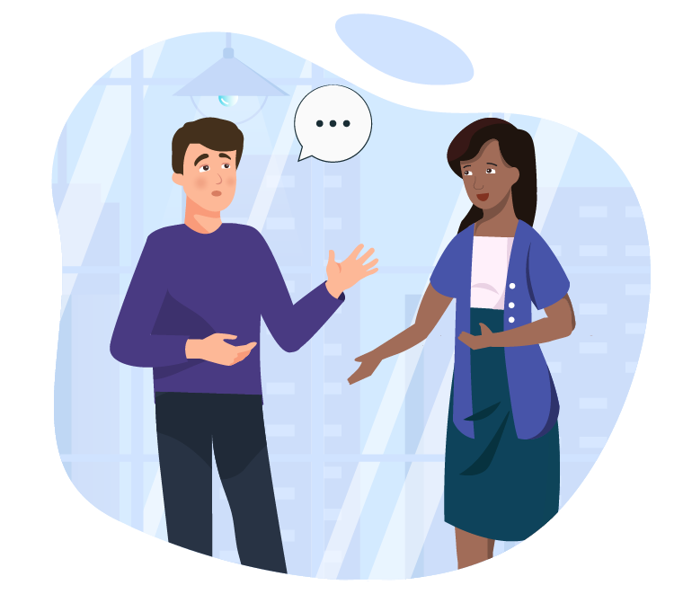
7. Expressing personal opinion
Council members have the right to express their personal opinions
Council members must not make any statements that could be seen as representing the official position of their council.
Make sure to say you are saying what YOU think and that you are NOT speaking for Council.
Remember, the Code of Conduct applies to anything that you post.
Notes:
As a council member, it is important to maintain a clear separation between your personal online identity and your councillor identity. You may speak personally, but must not mislead the public about your role or undermine council decision-making.
State when views are your own and not that of the council.
It is worth checking your Council’s media and social media policy to make sure your posts are okay.
Make sure your posts are respectful. Never share confidential information.

Slide 10

Case scenario 1
Mike is a passionate about community development.
On his personal Facebook page, he posts criticism of what he sees as his council’s inaction and slow response to community issues.
His profile identifies him as a “sometimes reluctant member of a certain council.”
He posts angry comments in response to his council’s online posts and ads.
Is this an issue? Why or why not?
2. How do we stay true to ourselves and still meet our responsibilities as elected members?
Notes:
Reluctant = unwilling
Mike’s criticisms of his council and his angry comments in response to the council’s posts and ads are a problem. These actions aren’t consistent with the standards of the code of conduct for elected councillors which all councillors must follow.
All councillors must instil confidence and trust and not bring the council into disrepute.
There may be times when our personal beliefs and values or political position will conflict with the work we are doing as councillors or with the direction our council is following. During these times, we need to remember what we were elected into office to do our work impartially and act with integrity, putting the interests of the community and council above our private interest.

Slide 11
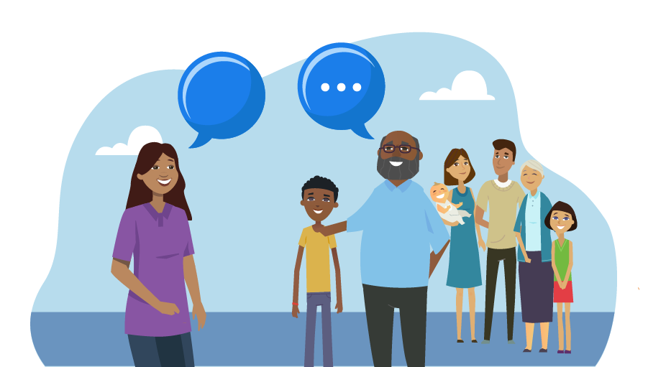
8. Receiving community requests or questions
When Council members use social media, they may receive comments from community members, such as requests, complaints or questions.
It is the job of council administration to find the answers to comments such as requests and questions.
Council members should send comments to council administration for a response.
Make sure you let the community member know that their comment/question has been received and sent to council
for a response.
Notes:
It’s important to remember that community members see their posts or comments on social media as contacting council in the same way as if they wrote a letter or an email. They expect a response.
If you are using social media to connect with your community, you should discuss and agree with your CEO on how to send comments or questions to council.
Make sure that you let community members know that you have passed on their request or question.

Slide 12
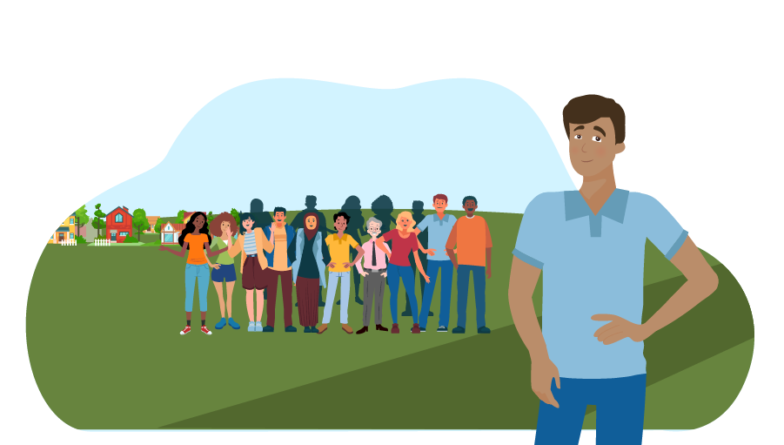
9. Using photos, videos & images
DOs
Use relevant, high-quality images or videos
Ask permission from each person before taking their photo and let them know the intended use of the photo
Ask permission to use an image or video that someone else created, even if you are in the picture
Credit the person who took the photo
Remove an image or video immediately if you are asked

Slide 13
10. Using photos, videos & images
DON’Ts
Use the image or video if you don’t know the creator
Post stock photos without giving credit to the owner
Use a photo if you don’t have permission from every person in the picture
Use images from the internet without checking the terms of use
Use images that may embarrass you or another person

Slide 14
11. Online bullying
As a council member, you are responsible for practicing good behaviour and maintaining respect towards other people.
The Code of Conduct prohibits all types of bullying behaviour, including:
Spreading rumours
Excluding others
Hurtful comments
Threats
This also includes cyber bullying, such as:
Sending nasty messages
Disrespectful comments on social media
Prank calls and harassment

Slide 15
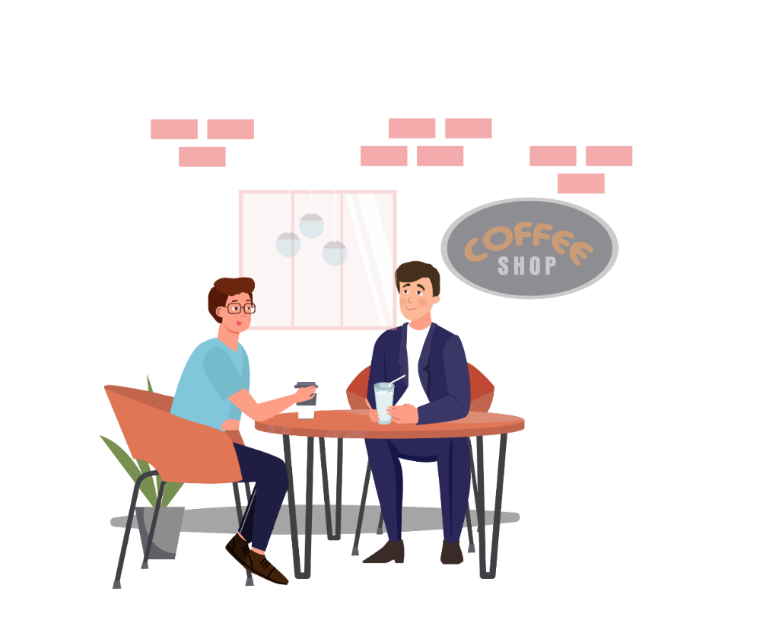
11.1 What to do if you are bullied online
Keep a copy of the offensive or harmful content (screenshots)
You could ask the person who posted the offensive post to remove it
Ask for advice from someone you trust – the CEO, a friend or family member
If the post is from a council member you may want to lodge a Code of Conduct complaint.
Report any posts that are bad trouble/ threatening to police.
Notes:
Keep evidence of the offensive or harmful content (screenshots). This may be needed for an investigation.
If you are comfortable doing so, you could contact the person who posted the offensive content and ask them to remove it. It is best not to respond on social media - remember, an offensive response from you may still be a breach of the law.
Seek advice from someone you trust – this could be the CEO, a family member, friend or fellow council member.
If the post is from a council member, you may want to lodge a Code of Conduct complaint. Always be respectful and model good behaviour towards others.

Slide 16

12. Social media DOs
What are your ideas?
If you are a council member, you are responsible for practicing good behaviour and being respectful towards others.
Ask your followers for their ideas on how to make the community a better place
Look for questions and comments from community members and tell them that their comments will be sent/passed on to council
Think about the things you post on your personal accounts
Report any posts that are bad trouble/threatening to police
Talk to someone if you are getting bullied online
Notes:
Always think about the things that you say/ put on your personal social media accounts. Your personal social media accounts can be mixed up with your work/position as a council member.

Slide 17
12.1 Social media DON’Ts
If you are a council member, it is important to think about what you put on social media and what you say on social media.
Don’t post things, comment on things, or share information that is gossip or will lie to people
Don’t post or say bad things about other people or about council
Don’t post anything confidential / secret, even if you don’t work for council anymore
Don’t post if you are not sure!

Slide 18
Case scenario 2
Lucy is part of an ongoing investigation about a complaint she launched about the mayor of her council. She is frustrated with what she sees as a lack of results.
She starts venting about her frustration on her private Facebook account, sharing details of the complaint.
Some of her Facebook friends are also staff of the council and one of them tells the council’s CEO about the posts.
Is this an issue? Why or why not?
2. What could Lucy have done instead?
Notes:
This is a serious issue. Complaints and investigations are confidential. Lucy is not allowed to share this confidential information, even in a private conversation with friends.
Lucy’s disclosure may be in breach of the Local Government Act 2019 and Code of Conduct. This type of breach must be reported to the council’s CEO (or Mayor). It may also be referred to ICAC depending on the severity.
Lucy’s need for emotional support and an outlet for her feelings is natural, but doesn’t justify her revealing confidential information. She could use other supports to manage her emotions without breaching confidentiality or putting an ongoing investigation in jeopardy. For example, she can talk with the CEO and other councillors about how she is feeling.

Slide 19
13. What if I have breached the rules?
If you think you have previously posted things that may cause trouble or harm it is best to remove (delete) the posts as soon as you can.
Council members’ behaviour, including on social media, must comply with the Local Government Act 2019 and the Code of Conduct.
Know your council’s policies about media and social media.
Notes:
It is important that you know the rules. Council members’ behaviour, including when using social media, is governed by the Local Government Act and the Code of Conduct.

Slide 20

14. Think before you post
Ask yourself:
Could my comments damage the reputation of council?
Would I be comfortable if the person I am commenting about read my comments?
Can I share this information?
You cannot share information that is confidential or share a council decision that hasn’t been publicly released by council administration.

Slide 21

Resources
For more information:
Information sheet – Personal use of social media
Code of Conduct
Ask your CEO
Ask the Local Government and Community Development Unit LGQuestions.DHLGCD@nt.gov.au
Notes:
It’s important to ask questions so you know your responsibilities as a member.

