Slide 1

Role of the Chair
Department of Housing, Local Government and Community Development
Elected Member Training
Learning and Development
Local Government and Community Development

Slide 2

Course Overview:
The role and functions of the Mayor / President
Skills to lead effective council meetings
What does it mean to be an effective Chair?
Different approaches to chairing meetings
The importance of collective council decision-making
Managing challenging situations when chairing meetings

Slide 3

Role of the Chair
Department of Housing, Local Government and Community Development
“Be the Chair you wish you had or would want to have”
Simon Sinek- CEO, Optimism.
Elected Member Training

Slide 4

Role of the Mayor/President
In addition to the role of a council member, the Mayor /President also does the following:
Chairs meetings and steers the council towards making collective decisions
Keeps order during meetings and enforces meeting rules if needed.
Promotes high standards and models good behaviour
Supports councillors to understand and perform their roles.
Speaks on behalf of council
Works closely with the CEO
Notes:
Section 44 of the Act – role of members – represent interests of residents, provide leadership and guidance, facilitate communication, be properly informed…. Ensure council resources are used prudently, actively monitor the financial affairs of council.
Section 59 of the Act – role and functions of principal member and deputy or acting principal member.
To chair meetings of the council
To speak on behalf of the council as the council’s principal representative - Also subject to council media policy
To liaise with the CEO about the performance of the council’s and CEO’s functions
To promote behaviour among members of the council that meets the standards set out in the code of conduct
To lead the council to undertake regular review of the performance of the CEO.
Section 95 of the Act states that the chairperson of a meeting of council is:
If the principal member is present – the principal member
If the principal member is absent – then the deputy
If principal member and deputy are both away – then acting principal member (if someone is acting)
If no principal member, deputy or acting principal member – then a member, chosen by resolution, by the members present at the meeting.

Slide 5

Effective Meetings: How?
Effective meetings are an important part of good governance.
Notice of meeting
Clear content (what is the meeting about?)
Meeting rules
Chairing meetings
Council decision-making
Notes:
Section 98 of the Act – Chairperson of a meeting of an audit committee, council committee or local authority.
Guideline 1: Local Authorities – Section 5.2 – Administrative support – ‘Council staff providing administrative support to meetings may, only at the request of a member, give informed advice during a meeting.’

Slide 6

Notice of Meeting
Preparation is key to a successful meeting.
Meetings are convened by the CEO.
The notice for a council meeting must:
be in writing
give the details of the meeting such as date, time, place, agenda (including confidential business)
be given to members and published on the council’s website at least 3 business days before the date of the meeting.
Notes:
3 days notice for ordinary meetings of council – 4 hours notice for special council meetings.
While the Chair does not have a direct role in providing the notice for a meeting, they work with the CEO to ensure there is good and timely information from the CEO and council officers to inform decisions. (Meeting agenda).

Slide 7
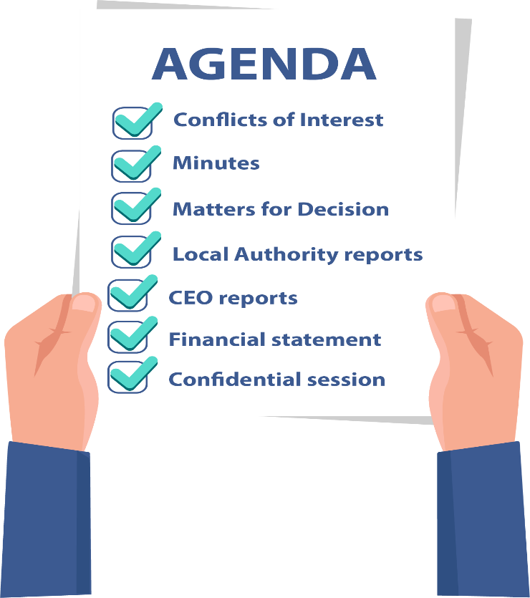
Clear Content (what is the meeting about?)
The agenda is prepared by the CEO in consultation with the Chair.
Council members can suggest agenda items.
The agenda provides a road map for the meeting.
It informs the community about the business of council.
A well-structured agenda is the key to an effective council meeting.

Slide 8

Meeting Rules
The council may want to determine its own rules and policies for meetings. These must comply with the Local Government Act and Regulations.
The Chair should ensure:
the meeting rules are followed
the meeting is kept on track and there is enough time for decision-making
there are good standards of behaviour (code of conduct)
minutes are being taken to record the decisions of council
everyone gets to have a say.
Notes:
Refer to the meeting rules, by-laws, policies of the council.
What happens if the Chair doesn’t do their role well? Unfortunately, we have seen what happens when the Chair doesn’t do their role well. Agendas and papers are not provided in advance, the meeting goes off track, people walk in and out of the room, it isn’t clear what council needs to make a decision. Decisions are not always recorded in the minutes. Council might not be provided with financial reports that they understand.
How can councillors support the chair in their role?

Slide 9

Scenario 1: Ensuring members feel their voice is heard
During council meetings, Megan is not getting the chance to speak
or she feels that she is not being heard when she does speak.
She feels upset and demoralised – especially as it happens time and again.
How would you handle this situation?
Notes:
The Chair can:
Call meeting to order and invite Megan to finish her statement and points.
Encourage Megan to voice her ideas by saying something like, “Megan, I’d really like to hear your thoughts on this before we move on” - this shows that her voice is valued.
If other members continue to speak over others, the Chair can intervene –
“Let’s pause – I want to make sure Megan can finish her point” – this models respectful bahaviour
Check with Megan after the meeting – “did you feel you had enough chance to contribute today?” – this shows that the Chair is paying attention and it builds trust
Allow every person a chance to speak in turn – i.e each person has a chance to speak once before anyone speaks twice
Meeting rules – such as time-limits for each speaker, no interruptions, a hands up or queue system.

Slide 10
Approaches to Chairing Meetings
Rule-keeper
Follows the rules
Keeps to agenda and timings
Relaxed
Conversational
This is how we do it
Headteacher
Follows the rules but flexible
Focus on outcomes
Adapts style to suit the situation
May not follow the rules
Practical Thinker
Directive (may be bossy)
Takes control when needed
May limit input from members
Laid-back
How would you describe your approach to Chairing meetings?
Notes:
There isn’t a single ‘best’ chairing style for every situation. A good chair blends their approach.
The Rule-keeper – strengths: ensure fairness and equal opportunity to contribute; keeps meetings efficient Risks: can feel rigid and strict; may stop creative discussion (Best when the group struggles with time-keeping; sensitive topics needs fairness and structure)
Laid-back – strengths: encourages open discussion; helps people feel comfortable and informal, good for brainstorming ideas Risks: meetings can drift or be very long; decisions may be unclear; quieter members (like Megan) may get drowned out (Best when the group already has good trust and balance; the goal is brainstorming ideas)
Head-teacher – strengths: used for conflict, tension or disorder; can reset the meeting rules; provides clarity and decisiveness Risks: can feel overly controlling, may limit imput from members and discourage dissent or challenge
(Best when the group is stuck or in disorder and behaviour needs firm boundaries)
Practical thinker – strengths: balances structure with openness; often the most inclusive and effective; flexible and responds to the group in real time. (Best when the group is diverse, need both inclusion and efficiency).

Slide 11

Chairing Meetings: Do’s and Don’ts
Do’s:
Steer and lead by example
Make all members feel valued
Encourage members to see others’ viewpoints
Listen and encourage discussion
Build general agreement
Form common purpose / team
Don’ts:
Be the person who does all the talking
Allow a few members to dominate meetings
Make all the decisions
Cut members out of discussions
Allow meetings to go off track
Ignore disrespectful behaviour

Slide 12

Scenario 2: Managing challenging behaviours
Max is a councillor. He is very eager to express his opinions at council meetings on all agenda items.
Max speaks early and often. He jumps in before others have finished speaking.
He responds to almost every point raised and he doesn’t pause to listen.
The other councillors see Max as over-confident and hasty. Some of them don’t speak in meetings and they let Max do all the talking.
How would you handle this situation?
Notes:
Max dominates the meeting. Impact – the meeting feels one-sided and other councillor don’t speak up to add their thoughts to decision-making. Other councillors may be frustrated and tensions grow.
The Chair can:
Ensure Max and all members understand their roles.
Maintain control of the meeting and in doing so set time limits for Max and other members to speak to the agenda items.
Intervene early in a calm tone of voice when Max jumps in – “Thank you, Max. I’ll come back to you once we’ve heard from the other councillors.”
“Max, you’ve already spoken to this item. I’ll now invite councillors who haven’t spoken yet to add their thoughts.”
Coach Max outside of the meetings – recognise his enthusiasm and passion. Explain the impact of his jumping in to speak. Invite him to help encourage others to speak.

Slide 13
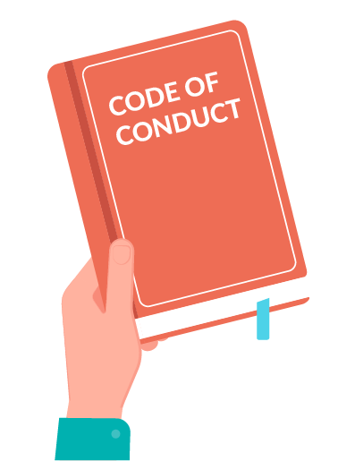
Scenario 3: Managing disrespectful behaviour
Jordan is a councillor. He often becomes dismissive when Councillor Harvey speaks.
Jordan interrupts Harvey, rolls his eyes, or makes rude comments under his breath.
The other councillors have noticed this behaviour and are uncomfortable, but no one has said anything.
How would you handle this situation?
Notes:
Harvey has become quieter in meetings, contributing less even when he has good ideas. Council meetings have become tense – and some councillors worry that the disrespect is affecting decision-making and working as a team.
Questions: What behaviours from Jordan are most disruptive to the meeting? How might Harvey be feeling about this behaviour? How does disrespect between councillors affect the overall culture and effectiveness of council?
Code of Conduct and meeting rules – the Chair can use to guide their response.
Points for how the Chair can address the situation on the next slide.

Slide 14
How? Managing disrespectful behaviour
Address the behaviour in the moment | a) Calmly call out the disrespectful behaviour, e.g “Councillor Jordan, please let Councillor Harvey finish his point” b) Refer to the meeting rules or code of conduct to remind everyone of the expected standards
Support the targeted councillor | For example, after an interruption, invite Councillor Harvey to continue speaking Thank him for what he has said to show that his voice is valued Check in privately after the meeting to make sure he feels supported
Speak to offending councillor privately | Discuss the behaviour – stick to facts and talk about the actions, not the person Explain the impact on meeting quality and how the council works together Set clear expectations for future conduct and offer guidance if needed
Reinforce meeting norms | At the next meeting, the Chair could remind everyone of the expected standards Encourage councillors to speak one at a time to avoid interruptions
Use Formal Tools if needed | Make sure councillors know the meeting rules and are following them Code of conduct process
Foster a healthy culture | Encourage quieter councillors to contribute their views Model respectful listening Consider training or workshops on communication and collaboration.
Notes:
Harvey has become quieter in meetings, contributing less even when he has good ideas.
Council meetings have become tense – and some councillors worry that the disrespect is affecting decision-making and working as a team.
Questions: What behaviours from Jordan are most disruptive to the meeting? How might Harvey be feeling about this behaviour? How does disrespect between councillors affect the overall culture and effectiveness of council?

Slide 15

Council Decision-making
The Chair has a responsibility is to ensure that the council works as a team to make decisions.
The Chair must ensure that members get the opportunity to express their view on issues.
This role is crucial because:
Members bring different perspectives and ideas on issues.
The strength of a council is not in the similarities of members but their individual differences.
The different views contribute to better council decisions.

Slide 16

What is effective decision-making?
It is transparent and open.
Aligns with the strategic objectives of the council and is within budget.
It is based on an understanding of the community and reflects community needs and preferences.
It is informed by good and adequate information.
It considers the views of all members.
Considers different options and chooses the best one.
It is understood by all the members of the council.

Slide 17
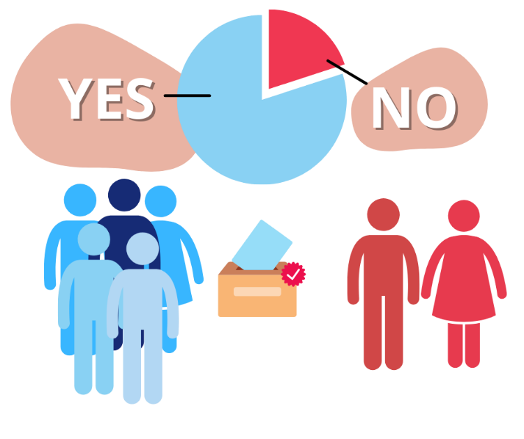
Voting
The Chair’s role in voting:
Make sure that a quorum is present
Before council votes on an issue the Chair should summarise the discussion
Read the decision out for recording in the minutes
Make sure that everyone votes – members must vote for or against a recommendation (it is not an option to abstain or not vote)
Make a casting vote if the vote is even (depends on council policy).
Notes:
A quorum must be present during the whole meeting. If a quorum is lost during the meeting, then decisions cannot be made. People can continue to discuss issues and share information, but they cannot make official decisions.
Each member has one vote, but some councils may have a policy that allows the chair a deciding vote if the vote is even.
Best practice – when weighing transparency in councillor voting against all councillors defending a council decision once it’s made.
Transparency in voting – open voting means residents can see how councillors voted; reduces suspicion of hidden agendas, community understands councillor’s positions on issues that matter to them. In practice, this looks like – recorded votes in the minutes, clear explanations of individual positions during debate, councillors feeling able to express a differing opinion before the vote.
Collective responsibility after the decision – once a vote is taken, councils operate under a principle of ‘collective responsibility’. This matters because council speaks with one voice, preventing confusion in the community, councillors uphold the decision-making process, even if they personally disagreed. It prevents ongoing public conflict that undermines the council’s credibility. In practice, this looks like – councillors may acknowledge they voted differently but they do not publicly undermine the final decision. They explain the decision respectfully and factually when asked by the public. They avoid blaming or criticising other councillors after the vote.

Slide 18
Supporting the decision
Principle | Purpose | Best Practice | Role of the Chair
Transparency in voting | Accountability | Votes are open, recorded and councillors freely express their views before the vote | Before the vote: Encourage open debate Ensure all councillors can express their views Keep the discussion respectful and focused on issues
Collective responsibility | Stability Public confidence | Once a decision is made, councillors support the decision as the official position of council. | After the vote: Remind councillors that the decision was made by the council as a whole Support councillors to explain the decision in public without undermining it
Notes:
Best practice – when weighing transparency in councillor voting against all councillors defending a council decision once it’s made. Good governance supports both!
Transparency in voting – open voting means residents can see how councillors voted; reduces suspicion of hidden agendas, community understands councillor’s positions on issues that matter to them. In practice, this looks like – recorded votes in the minutes, clear explanations of individual positions during debate, councillors feeling able to express a differing opinion before the vote.
Collective responsibility after the decision – once a vote is taken, councils operate under a principle of ‘collective responsibility’. This matters because council speaks with one voice, preventing confusion in the community, councillors uphold the decision-making process, even if they personally disagreed. It prevents ongoing public conflict that undermines the council’s credibility. In practice, this looks like – councillors may acknowledge they voted differently but they do not publicly undermine the final decision. They explain the decision respectfully and factually when asked by the public. They avoid blaming or criticising other councillors after the vote.
A councillor might say “I voted against the motion, but the council as a whole has made its decision and I support implementing it”

Slide 19

Scenario 4: Dealing with conflict
Sarah has served on ABC council as the Deputy for a long time. At times, when the Mayor is an apology, she acts in the role of Chair for meetings.
She holds strong views on her value and mission on the council and wants to keep a firm grip on council decisions.
Is Sarah’s behaviour good or bad for council? Why?
How would you handle this situation?
Notes:
The Chair can:
Recognise and respect Sarah’s past achievements and strategies and thank her for his involvement. However, point out the need for council collaboration especially when the council needs to make decisions.
Clarify the decision-making processes for council matters as a whole with emphasis on the use of consensus and voting.

Slide 20

Resources
For more information, view the following resources:
Chapter 6 – Meetings Local Government Act 2019 (the Act)
Code of Conduct - Schedule 1 to the Act
Guide to Meeting Procedures

