Slide 1


Department of THE CHIEF MINISTER & CABINET
Introduction to the Code of Conduct
Elected Member course 2021/22

Slide 2

Course overview
An understanding of the Code of Conduct
The behaviours expected of council members are outlined
What happens if a member breaches the Code of Conduct?
Where to find further information?

Slide 3
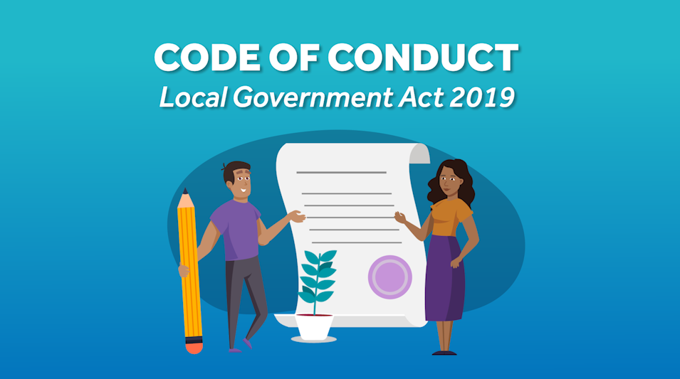
Code of Conduct - YouTube

Slide 4
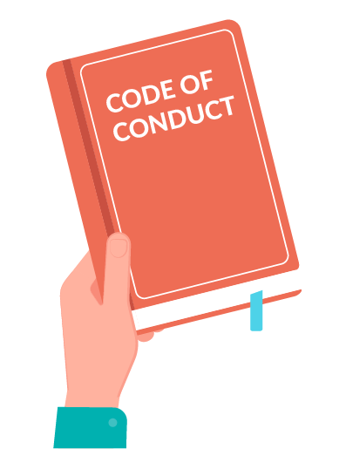
What is the Code of Conduct?
The Code of Conduct outlines the values and standards Council and Local Authority members are expected to follow.
The Code of Conduct is important because it guides behaviour and decision making in performing council duties.
The Code of Conduct also lets the community know what standards they
can expect from council members.
Notes:
The Code of Conduct sets out guidance on the minimum professional standards expected of councillors. As public officers councillors will be held to account by their electorate fellow councillors, the Department as the regulator and increasingly external bodies such as ICAC.
The Local Government Act has introduced a new process for code of conduct breaches, placing responsibility on councils to manage behavioural matters in the first instance, unless either party wants to refer the matter to a third party.
ICAC powers to investigate behaviour include corrupt conduct, misconduct, unsatisfactory conduct, and anti-democratic conduct. There are currently a number of reviews and investigations in train.

Slide 5

1. Honesty and integrity
The Code of Conduct requires council members to
behave with honesty and integrity when performing duties.
Examples of honesty and integrity include being transparent and open during debate, being accountable for your behaviour and decisions, and being reliable.
Remember, you are representing the needs and interests of your whole community and making decisions about services that affect their daily lives and the use of public resources.
Notes:
Holders of public office must avoid placing themselves under any obligation to people or organisations that might try inappropriately to influence them in their work.
Holders of public office should act solely in terms of the public interest. They should not act or take decisions in order to gain financial or other material benefits for themselves, their family, or their friends. They must declare and resolve any interests and relationships.
They must consider their interests and biases and be open about these in order to ensure decisions are made in the interests of the community as a whole and on the basis of the best available evidence.

Slide 6

2. Care and diligence
Council members need to act with reasonable care and diligence in performing their duties.
This includes reading the agenda ahead of the council meeting and taking into account all of
the information that is available to ensure you
are well informed before reaching a decision.
It is important to think carefully, considerately
and diligently when carrying out your duties.
Notes:
It is also important to take care in relation to personal actions that may reflect on the reputation of the Council. As a Councillor in the public eye your actions may be under increased scrutiny. Be careful when doing things such as liking posts on social media, particularly if they are not in line with the policies and values of the Council.

Slide 7

3. Courtesy
Be courteous towards other members, council staff, electors and the community.
You can do this by being polite and respectful, listening to what others have to say, being on time to council meetings and being considerate of others.

Slide 8

4. Bullying
As a council member, you are responsible for practicing good behaviour and maintaining respect towards other members.
The Code of Conduct prohibits all types of bullying behaviours, including:
Spreading rumours
Excluding others
Hurtful comments
Threats
This also includes cyber bullying, such as:
Sending nasty messages
Disrespectful comments on social media
Prank calls and harassment
Notes:
It shouldn’t need to be said but in order for the community and council staff and management to look to your for leadership then the council as a whole and individual councillors must set the culture. This includes zero tolerance of bullying.
Example – Council makes a decision about a development. Some councillors are not happy with the decision and expressed their views at the meeting. They also expressed their views on facebook after the decision was made, saying the Mayor had pushed for the decision.
The Mayor threatened defamation proceedings and then in a subsequent meeting he proposed and voted on a resolution requiring the members to withdraw their facebook posts and apologise. The motion passed because the members concerned removed themselves because of a conflict of interest.
While the members breached the code of conduct and undermined the council decision making process, the Mayor was also in breach for not removing himself from a vote in which he had an interest.

Slide 9
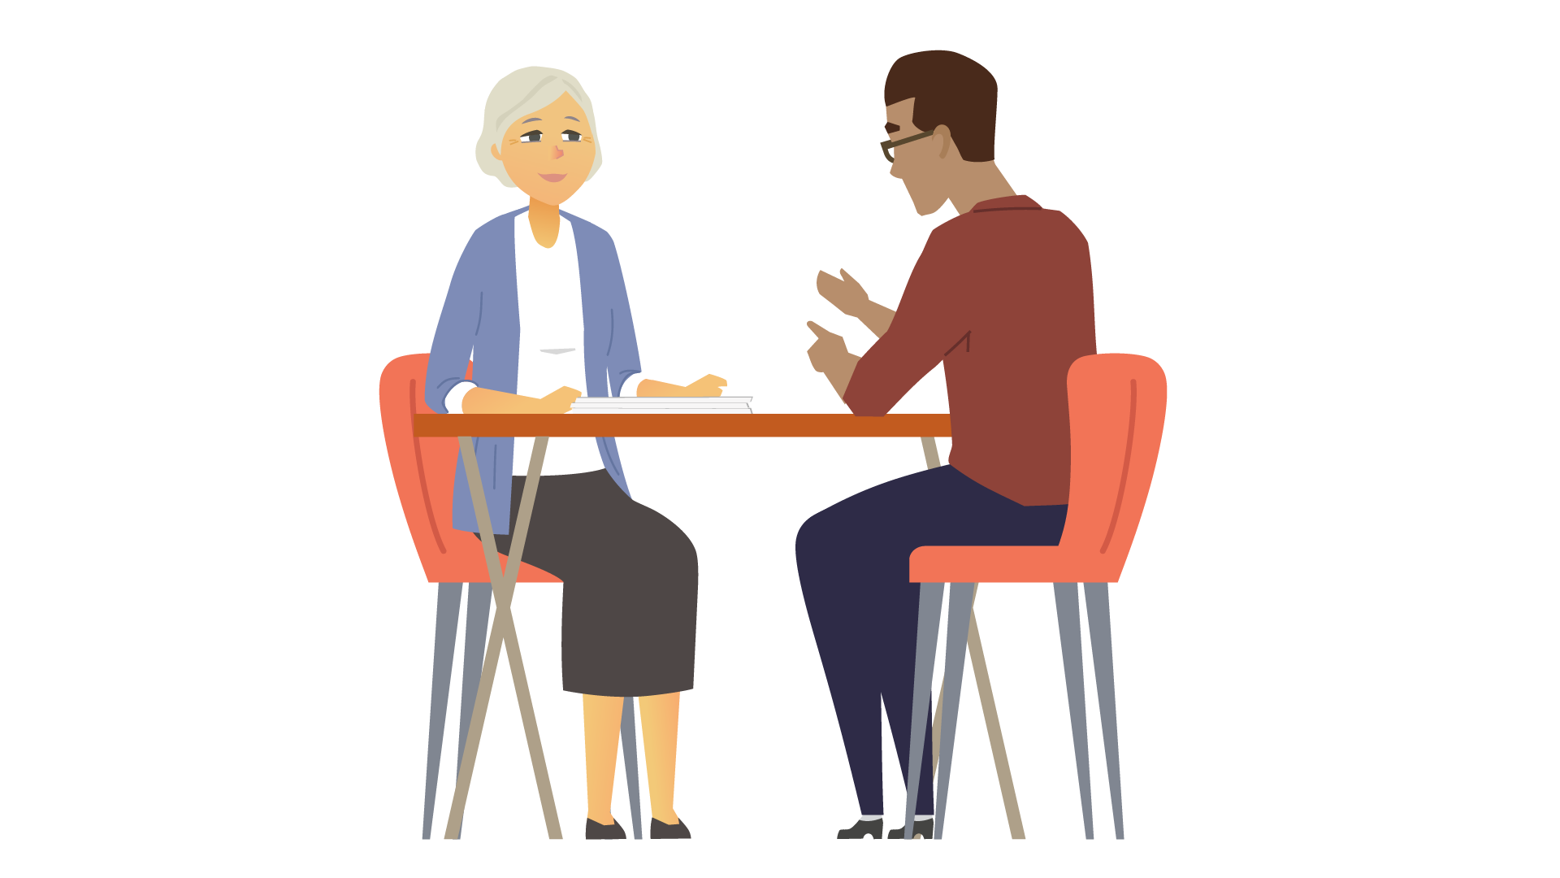
5. Conduct towards council staff
As a council member, you must not interfere in the management of council staff.
Council members do not have authority to direct, manage or reprimand council staff (other than the CEO). For example, a member should not criticise or say something bad about council staff in the open section of council meetings.
The CEO is responsible for managing council staff, employees and contractors. If you have an issue in relation to council staff you should talk to the CEO. Council is responsible for managing the CEO.
Notes:
Council should be seen to working in unity with council staff in order to deliver the best outcomes for the community. Undermining or demeaning of council staff reflects badly on the council as a whole.
Think about how you interact with staff members – tone of voice, implicit authority. Eg Code of Conduct complaint against a councillor who submitted something to a council publication that was edited by staff member. Councillor was particularly insistent that his piece was included and flooded the staff member with email communications.

Slide 10

6. Respecting cultural diversity
You must always be respectful of other people’s beliefs and practices.
You must not discriminate against others based on their cultural background.
For example, people from different cultures may use different ways of expressing themselves and communicating or there may be issues that prevent them communicating, such as avoidance relationships.
Notes:
This also extends to diversity in analysis and decision making. Councillors come to the table with different experiences and backgrounds and all of them can contribute to better decisions. It is important that different points of view are encouraged rather than just deferring to the loudest voices or the most prolific contributors.

Slide 11
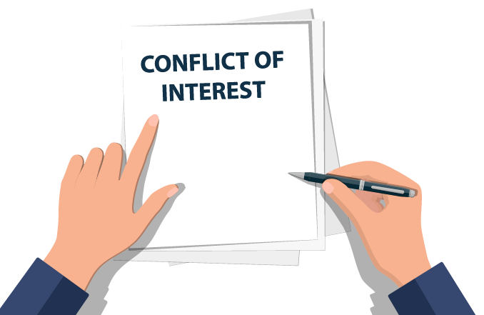
7. Conflict of interest
Council members need to avoid conflicts of interests when undertaking official functions and responsibilities.
Conflicts of interest include actual conflicts and also perceived conflicts, where a reasonable person might expect that a conflict exists.
A conflict of interest is when your duty as a council member conflicts with another interest that might mean you, or someone close to you, gets a benefit or is otherwise impacted by a decision.

Slide 12
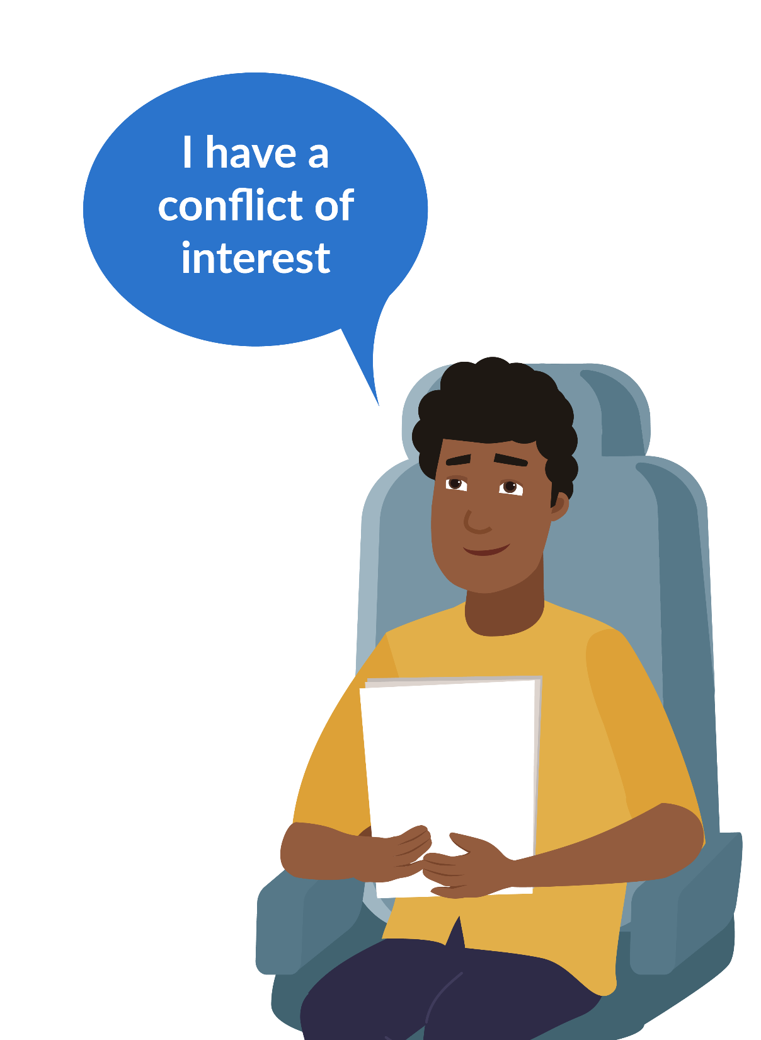
7.1 Conflict of interest
It is your responsibility to declare any conflicts of interests before taking part in a council decision.
If you do not declare your conflict of interest and participate in a council decision, you could be in breach of the Local Government Act 2019 and penalised.
It also may result in the council decision being declared void, or of no effect.

Slide 13
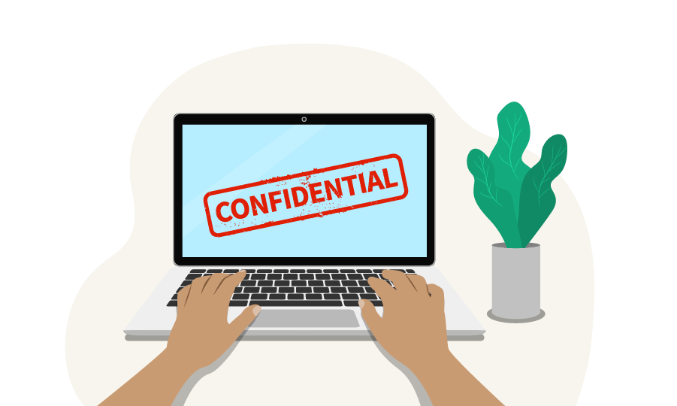
8. Confidential information
As a council member, you will occasionally receive information that is considered confidential.
Confidential information must be kept private and not talked about with others who are not part of the confidential session of the meeting.
You must not use confidential information in a manner that could gain a private benefit or to
cause harm to another person.
You have a professional duty to maintain the integrity
and security of confidential information.

Slide 14

9. Gifts
You must not accept or encourage gifts or private benefits from someone that may be interested in receiving a benefit from the council.
This is because it may raise the perception of bias or favouritism, especially if that person could benefit from or influence a council decision.
Look to your Council Gifts policy or talk to the CEO for further information.

Slide 15

10. Accountability
Council members have an important role to represent the community.
They should talk to people in their community regularly, talk to council meetings about what the community wants, and report back to the community about what council is doing.
Notes:
Holders of public office are accountable to the public for their decisions and actions and must submit themselves to the scrutiny necessary to ensure this. Council meetings are held in public and papers and decisions are publically available. There are few limited exceptions to the requirement that council business is open and transparent.
Councillors have promised in their election campaign to deliver on certain things. We have examples where their commitments to advocate for issues were areas outside of the Council’s jurisdiction or where maintaining a green space for the community had to be weighed against income that might be made through using it for other priorities.
It is important to provide feedback to the community about these things – not by saying you disagree with decisions properly made but by demonstrating a commitment to council processes and indicating that decisions are made weighing up all the factors, some of which might not have been known to you at the time.

Slide 16

11. Putting the interests of people in your council area first
As a council member, you must always act in accordance with the best interests of your communities.
As a council member, you represent all residents in your entire council area (not just residents from your ward).
When making council decisions, always consider how this will affect the entire council area and whether this would be in the long-term interests of all residents.
You must ensure your decisions and actions are based on an honest, reasonable and properly informed judgment about what
is in the best interests of the people living in the council area.

Slide 17

12. Training
As a council member, you will have opportunities to undertake training in relation to your council.
There are some training courses that you must do so you understand your role as a councillor and can represent your community well. If you are offered training, you should do it if you can and try and apply the training to help you perform your duties as a councillor.
The Code of Conduct states that you must undertake training in good faith, which means genuinely participating in training opportunities.

Slide 18

13. What happens if a council member breaches the Code of Conduct?
If someone thinks that a council member has breached the Code of Conduct, a complaint can be submitted with the CEO of the council.
The council may decide the complaint, or refer the complaint to a council panel for decision or to a third party for advice.
The member complained about can also ask the council to refer the complaint to a third party. The decision on a breach of the code
of conduct might include issuing a reprimand, or recommending
that the council member attend training or mediation.
A breach of the code of conduct may also be a breach of the
Independent Commissioner Against Corruption Act.

Slide 19

Quiz

Slide 20

1. What should a council member do to be accountable to the community?
Select one:
  Attend council meetings
  Talk to people in the community about council business
  Ensure council money is spent well
  All of the above
Correct. Being a council member is an important role and all of these things are part of performing your duties.

Slide 21
2. It is okay for council members to accept gifts or benefits that might influence their decisions.
Select one:
True
False
Correct. Council members need to make sure that they are making decisions in the best interests of all the people in the council area. If someone gives you a gift it may look like they are trying to get you to make a decision in their favour, and accepting the gift is in breach of the Code of Conduct. Look to your Council Gifts policy or talk to the CEO for further information.

Slide 22
3. Who should follow the Code of Conduct?
Select one:
Only the Mayor or President
All council and local authority members
Only the CEO and council staff
Correct. All members, including council members, must follow the Code of Conduct, including the Mayor or President. The CEO and council staff have different codes of conduct as they have different roles and responsibilities.

Slide 23
4. Council members must not share confidential information.
Select one:
True
False
Correct. As part of their role, council members will have access to confidential information that is private and must not be shared with anyone outside of the confidential session of the council meeting.

Slide 24
5. Why is it important to have a Code of Conduct?
Select all that apply:
To let council members behave as they want because they have been elected
To uphold a high standard of behaviour and professional conduct for all council and local authority members
To make sure members are accountable for their behaviours and actions
Correct. The Code of Conduct sets a standard of behaviour and conduct for all council and local authority members and ensures that members are accountable.

Slide 25
6. What behaviours might be considered bullying?
Select all that apply:
Spreading rumours
Hurtful comments
Having a different opinion
Excluding others
Correct. All of these things will affect the Council acting as a team and working together. While people may have different views and disagree on things, working these things out without getting personal will mean Council will make better decisions.

Slide 26
7. The Code of Conduct outlines the values and standards members are expected to follow.
Select one:
True
False
Correct. The Code of Conduct is there to guide members on what values and standards are acceptable and what is not acceptable

Slide 27
8. What is included in the Code of Conduct?
Select all that apply:
A duty to act honestly and with integrity
To represent only the people who voted for you
To complete training in good faith
To respect cultural diversity and culture
Correct. All of these things are important and it is up to council members to act in the best interests of all the people in the council area and not just the community where you live or the people who voted for you.

Slide 28
9. What is the Code of Conduct intended for?
Select all that apply:
Acts as a guide for good behaviour and decision making
Gives permission for council members to manage council staff
Lets community members know what standards they can expect from council members
Outlines the values that council members need to follow
Correct. It is both a guide for members and for the community on what standards to expect.

Slide 29
10. What are examples of being courteous?
Select one:
Being polite and respectful
Listening to what others have to say
Being considerate of others
All of the above
Correct. Acting with courtesy is a part of the Code of Conduct. It is important that everyone’s views and time is respected.

Slide 30

Resources
For more information, view the following resources:
Code of Conduct - Schedule 1 of the Local Government Act 2019
Code of Conduct complaints process –
Part 7.4 of the Local Government Act 2019

