Slide 1


Department of THE CHIEF MINISTER & CABINET
Understanding conflicts of interest
Elected Member course 2021/22

Slide 2

Course overview
Introduction to what is a conflict of interest for a council member
Ability to understand and identify when conflicts of interest arise
Understanding how and when to disclose a conflict of interest
Understanding how to manage a conflict of interest and where to seek support

Slide 3

Conflict of Interest - YouTube

Slide 4

1. What is a conflict of interest?
A conflict of interest is when your duty as a Council member conflicts with another interest that might mean you, or someone close to you, gets a benefit.

Slide 5

1.2 What is a conflict of interest?
Having a conflict of interest raises a question of whether your actions, judgements or decisions can be unbiased.
If a member has a personal or financial interest in a decision, they need to declare their conflict of interest and not participate in the decision.
A member can be a council member, local authority member or a council committee member.
Notes:
The Local Government Act is very strict about conflicts of interest. If a member declares a conflict of interest then they must leave the room and not participate in any discussions around the matter.

Slide 6

1.3 What is a conflict of interest?
Interests cover your personal interests and those of someone close to you. This can include:
  involvement in an organisation that deals with the Council or does work for the Council
  any benefits, concessions or discounts that you
  receive that may conflict with your public duty
  gifts received that may influence or be designed
  to influence your decision making
  interests in land, property, housing, infrastructure
  that may be subject to Council decisions

Slide 7

1.4 What is a conflict of interest?
Council members have a duty to declare a conflict of interest.
Not declaring is an offence under the Local Government Act 2019 and breaches the Code
of Conduct.
It may also be improper conduct under the Independent Commissioner Against
Corruption Act 2017.

Slide 8

2. How do I identify a conflict of interest?
There are many varieties of conflicts of interest, and they appear in different settings and circumstances.
If you are unsure of whether you have a conflict of interest, always ask yourself whether you, or someone close to you, has an interest in a council decision.
Someone close to you might include a family member or relative, roommate, friend, business partner or business relationship (like a company you regularly do business with).
If the answer is yes, you have a conflict of interest.
Notes:
It is sometimes hard for individuals to see conflicts of interest themselves and so seeking advice can give you a better idea of how it might be perceived by someone else.
Example – Councillor on school board – issues around road access and car parking. Resolution put to council for what he described as a win-win solution.
DCC waived the fee for the Great Moscow Circus to use Mindil beach land in exchange for 700 tickets to the circus (30 tickets for each councillor) in a confidential deal.

Slide 9

2.1 How do I identify a conflict of interest?
All types of conflicts of interests need to be declared, including perceived, actual and potential conflicts.
It is your responsibility to check through all of the agenda items before the meeting, and ask yourself if you have a conflict of interest.
Notes:
The Act refers to different types of conflict of interest.
Direct interest e.g. a company controlled by a member is tendering for a council contract.
Indirect financial interest, e.g. a member is employed by a company that is tendering for a council contract.
Indirect interest by close association, e.g. a member’s sister was contracted by the council to provide services and has not done so, resulting in the council considering action against her.
Indirect interest due to conflicting duties, e.g. a member is a member of an organisation seeking funding from council.

Slide 10

3. Direct conflict of interest (scenario)
v
Bernie is a council member. He also runs a gardening business. The council wants to employ someone to mow the grass in the council playground and asks for quotes for the work. Bernie submits a quote to do the job.
When Council is considering who to give the job to, Bernie should remove himself from the room and should not be part of the decision. Bernie has a conflict of interest because he benefits from that decision if he wins the job.
After the other council members have made a decision, Bernie can return to the meeting room. He must not make comments or ask questions about their decision, as the council may not have reached a decision yet and have moved to the next agenda item. Bernie will be able to
view the decision from the meeting minutes.

Slide 11

4. Conflict of interest (scenario)
v
Mary is a council member. At the council meeting, the council needs to decide which roads to improve this year. One of the roads to be considered is the road to Mary’s family’s outstation. Mary has a conflict of interest because the road would provide a benefit
to her family.
However, if the road also serviced other outstations or other parts of the community then Mary does not have a conflict of interest because the road will also benefit the wider community and not just Mary’s family.

Slide 12

5. Indirect financial interest (scenario)
v
Angela is a council member. Her term expires in a month and she will then take up a position as a receptionist at ABC maintenance.
ABC have put in a tender to the council to provide maintenance for the public toilets in the park. Angela has a conflict of interest because she will be employed by ABC in the future and may benefit from the company’s success in winning the contract. This is called an indirect financial interest.
Angela must leave the room and not take part in any decision making.

Slide 13

6. Perceived conflict of interest
Sometimes, you might not have an actual conflict of interest, but it may be perceived that way to other people (reasonably, of course).
This is called a ‘perceived conflict of interest’ and is just as significant as having an actual conflict of interest.
Notes:
These situations are difficult because it may not be an actual conflict of interest, however how people perceive the workings the council is important.

Slide 14

6.1 Perceived conflict of interest
For example, if your friend is tendering for a contract with the council, you might not have an actual conflict of interest.
But it might be perceived that way by others (for example, members in the community, stakeholders or the media).
In this situation, it is always safest to declare a conflict of interest and not participate or make comments on the council’s decision.
Notes:
If a friend of yours is applying for the CEO position or an organisation you used to work for is going to be benefit form the development of an industrial area then others might think that you influenced council on their behalf.
In short, if someone is likely to make a complaint it is worth considering whether a perceived conflict of interest might exist and, if so, removing yourself from decision making.

Slide 15

7. What should I do if I have a conflict of interest?
Don’t be embarrassed if you have a conflict of interest.
Councillors have good connections with the community and usually have a variety of family, social, sporting and business relationships and so conflicts of interest often arise.
Every year a Council member must provide information about their interests in an annual
return. Gifts and interests will then be put on a register which is available to the public.

Slide 16
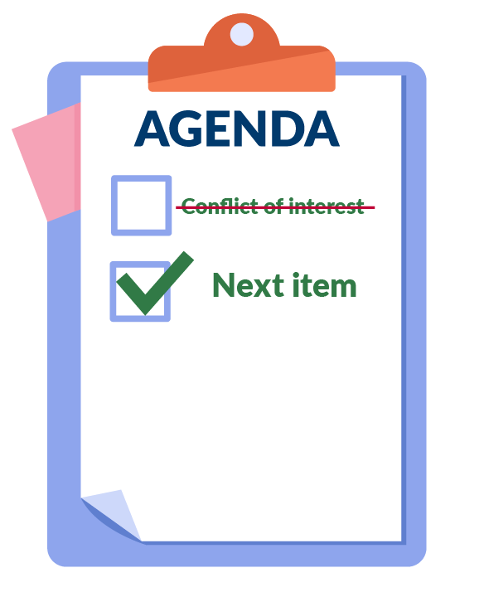
7.1 What should I do if I have a conflict of interest?
As soon as you become aware of a conflict you should declare it.
You can choose to declare it before the meeting to the CEO or at the start of a meeting.
If you don't realise you have a conflict until later in the meeting, you need to declare as soon as you realise.
When the item with which you have a conflict comes up for discussion you should leave the room. When the discussion has finished, you may re-enter the room. Remember - you cannot take part in any decision making in relation to that item.

Slide 17
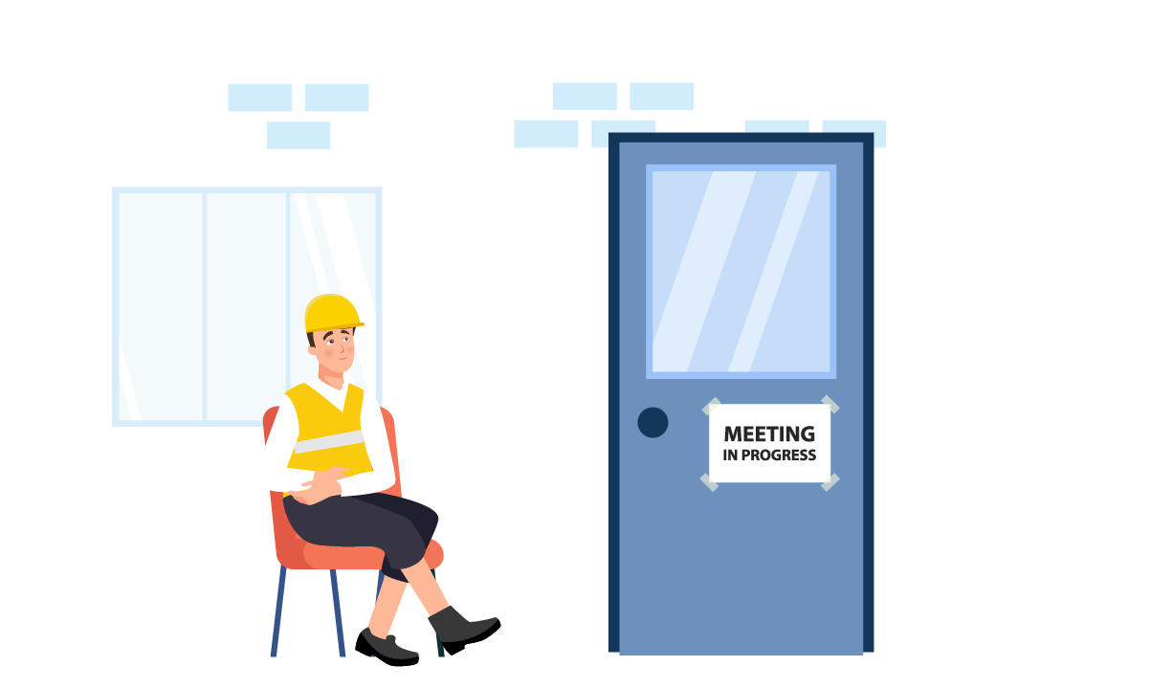
7.2 What should I do if I have a conflict of interest?
If you are unsure about whether you have a conflict of interest, it is better to declare it anyway.
You must not make any comments on the decision before or after you leave the room, as the matter may still be in question and you are potentially influencing the decision.

Slide 18

8. What happens if I don’t disclose the conflict of interest?
Not disclosing a conflict of interest is an offence under the Local Government Act 2019 and breaches the council’s Code of Conduct.
It may also be improper conduct under the Independent Commissioner Against Corruption Act.
Disclose the conflict as soon as you realise it. If you forget to disclose a conflict at the start of the meeting, disclose it as soon as you remember.
If you do not disclose a conflict of interest or do not leave the meeting room, the decision made can be questioned by a court and overturned or cancelled.

Slide 19

8. What happens if I don’t disclose the conflict of interest?
I have a conflict of interest
Your reputation in the community may be damaged if you are seen to be getting benefits for yourself, your family, friends or business partners because of your role as a council member.
It is always safest to declare a conflict of interest and to not participate in council’s discussion or decision.
This will help to ensure that decisions are made in the best interests of the whole community.

Slide 20

When it’s not a conflict of interest
In some circumstances you do not have a conflict of interest, if the interest is shared with other people in the community or residential area.
For example, you might need to make a decision about whether to upgrade the footy oval in your residential area or increase rates.
These situations are not conflicts of interest, as the interest is shared by others in the community.

Slide 21

Who can I talk to?
If you are unsure about whether you have a conflict of interest, you can talk with your CEO or the Chair.
If you think another member has a conflict of interest you should talk to the Chair.
It’s important to ask questions so you know your responsibilities as a member.

Slide 22

Quiz

Slide 23

1. Why is it important to declare a conflict of interest?
a. It is a requirement of the Local Government Act 2019.
b. To make sure council decisions are in the best interests of the community.
c. To comply with the Code of Conduct.
d. All of the above
Correct. These are all important and are aimed at making sure that Council makes good and fair decisions.

Slide 24
2. When should you declare a conflict of interest?
a. Only at the start of the meeting during the relevant agenda item.
b. At any time when you become aware of the conflict.
c. You don’t need to worry if the meeting is over.
Correct. Declare a conflict of interest as soon as you know about it. In some cases you may not become aware of a conflict until a matter is discussed but it is still important to declare it.

Slide 25
3. What types of conflicts of interest must you disclose?
a. Only when I will personally benefit from the decision.
b. All conflicts of interest, including actual and potential conflicts.
c. Only when you think someone might complain about it.
Correct. It is important that you disclose everything that may look like a conflict of interest even though it might not be.

Slide 26
4. Even if you have a conflict of interest, you can still make a few comments before you leave the meeting room.
True
False
Correct. It is better not to say anything so that you cannot be accused of influencing the decision.

Slide 27
5. If you are unsure if you have a conflict of interest, it is safer to say so and leave the meeting room.
True
False
Correct. It is better to do this than have someone make a complaint about you later.

Slide 28
6. If you have a conflict of interest it is okay to stay in the room while a matter is being discussed, as long as you don’t vote on the decision.
True
False
Correct. If you have declared a conflict of interest you should leave the room so that no-one can say you influenced the decision. You should also ask that the minute taker records when you leave and when you return.

Slide 29
7. Which of the following are conflicts of interest
(select all that apply)
Council is considering offering my sister’s business bookkeeping work.
A community organisation seeking a grant from Council has sent me free tickets to a concert.
The Council is upgrading the street lighting in my whole area.
My employer is seeking to get a contract to do work with the Council.
Correct. If the decision might benefit you or one of your family members then it is a conflict (even if it just looks like you might benefit). However if the Council is providing services that benefit a broader group in the community or all the people in the Council area that would generally not be seen as a conflict.

Slide 30
8. If the council is going to upgrade the football oval and you use the football oval along with other members of the community is this a conflict of interest?
Yes
No
Correct. If you or one of your family members directly gains from a decision then it is a conflict. However if the decision applies to a lot of people in the council area then it is not a conflict.

Slide 31
9. A ‘perceived conflict of interest’ means that a reasonable person might think you have a conflict of interest, even if you don’t. Do you have to declare a perceived conflict of interest?
Yes – I need to always be thinking about how others might see things and declare when I have a perceived conflict of interest.
No – It doesn’t matter what other people think.
No – I only need to declare when I have an actual conflict of interest.
Correct. It is safer to declare it as others might think you have a conflict of interest.

Slide 32
10. You are reading the agenda papers for a meeting and you are concerned that another member has a conflict of interest. What might be the best action you could take?
a. Do nothing as this is the member’s own decision.
b. Raise your concern with the member and the Chair in a conversation before the meeting.
Say nothing and then ask the member why they haven’t declared when the agenda item is being discussed.
Correct. All of the members of council are responsible for the decisions made. A decision may be cancelled by a conflict of interest and so it is important that the matter is raised. It is good to raise it with the person who may have a conflict – sometimes it is difficult to know if you have a conflict or not. It is also good to raise with the Chair, who is responsible for running the meeting and can raise it when it comes up on the agenda.

Slide 33

Resources
For more information, view the following resources:
The Local Government Act 2019 at Part 7.2 talks about declaring interests, conflict of interests, and gifts and benefits.
The Code of Conduct is contained at Schedule 1 to the Act also covers the areas in this module.

