Slide 1



Council meeting procedures and decision making
DEPARTMENT OF THE CHIEF MINISTER & CABINET
Elected member course
cmc.nt.gov.au

Slide 2

Course overview
1. Council meetings
  When are they held?
  What happens before a meeting?
  What happens at a meeting of council?
  Different types of meetings
2. Making Decisions
3. Council committees.

Slide 3



Video introduction
Notes:
https://www.youtube.com/watch?v=trdxtrX2PwQ

Slide 4

Council Meetings

Slide 5
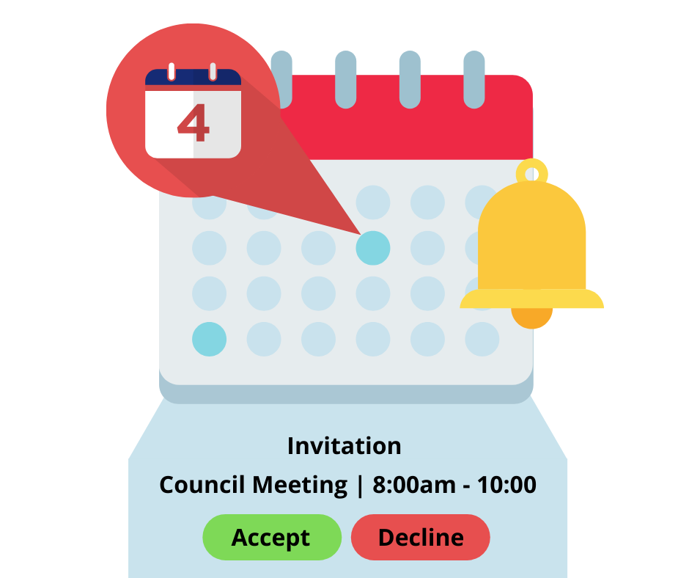
Council meetings – when are they held?
The first council meeting is to be held within 21 days of the election results.
After this, the council must meet at least once every 2 months.
Council meetings are called by the CEO.
Notes:
There will be a plan or schedule of meetings.
LGGR 19(1) If a council does not schedule an ordinary meeting at least once a month it must delegate to a council committee the necessary powers to carry out the financial functions of the council. A Finance Committee will perform the role of the council in between meetings of council.

Slide 6

Before a meeting

Slide 7
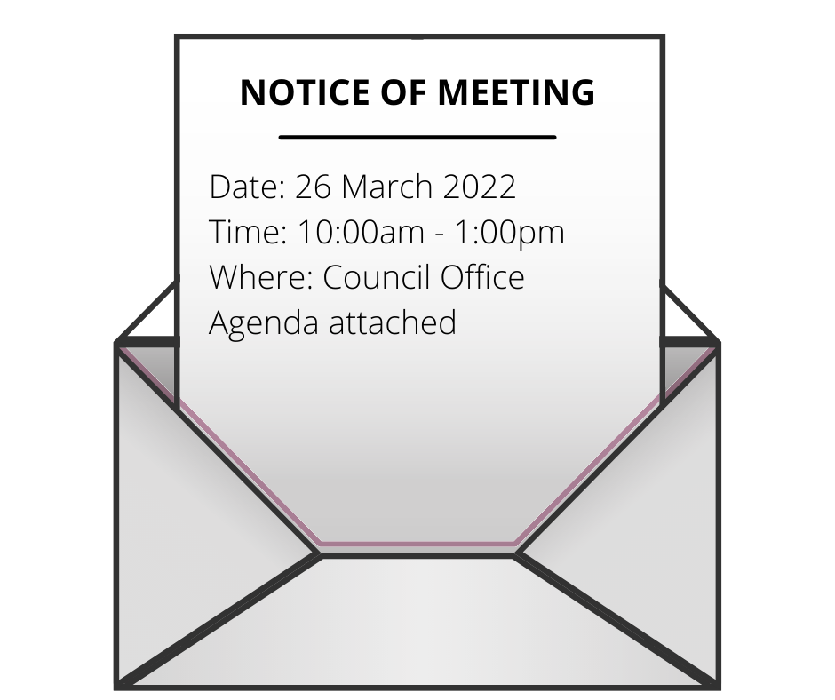
Notice of a council meeting
Notice for a council meeting must:
be in writing;
give the details of the meeting such as date, time and place and the agenda and papers; and
be given to members and published on the council website at least 3 business days before the date of the meeting.
Notes:
Elected members can ask the CEO to issue the meeting papers earlier.

Slide 8


Preparing for a meeting
It is important that all members
read the papers before the meeting,
consider if you might have a conflict of interest.
ask questions if things are unclear, and raise any issues or concerns. *
seek community views on agenda items.
Notes:
* Many councils have a briefing session before the meeting where you can do this. However decisions can not be made at the briefing session.

Slide 9

At the meeting

Slide 10

Openness and accountability
Openness and accountability help people in your area understand the business of council and shows that the council is answerable to its community.
Notice and papers for the meeting are posted on the council website and made available to the public.
Council meetings are open to the public so that the people in your area can see how you make decisions.
Members of your community can ask questions at council meetings.
.
Notes:
If a lot of people turn up to a council meeting then councillors will know that decisions on the council agenda are very important to the community and might be controversial.
It also might give council an indication of what issues require more consultation.
Eg when Darwin City Council was asked to make a decision about whether the RSL should build their club on the Esplanade so many people turned up that there was a line outside the doors of council. (picture)
Council in that case decided to defer the decision, conduct an investigation, and
consult further before they made their decision

Slide 11
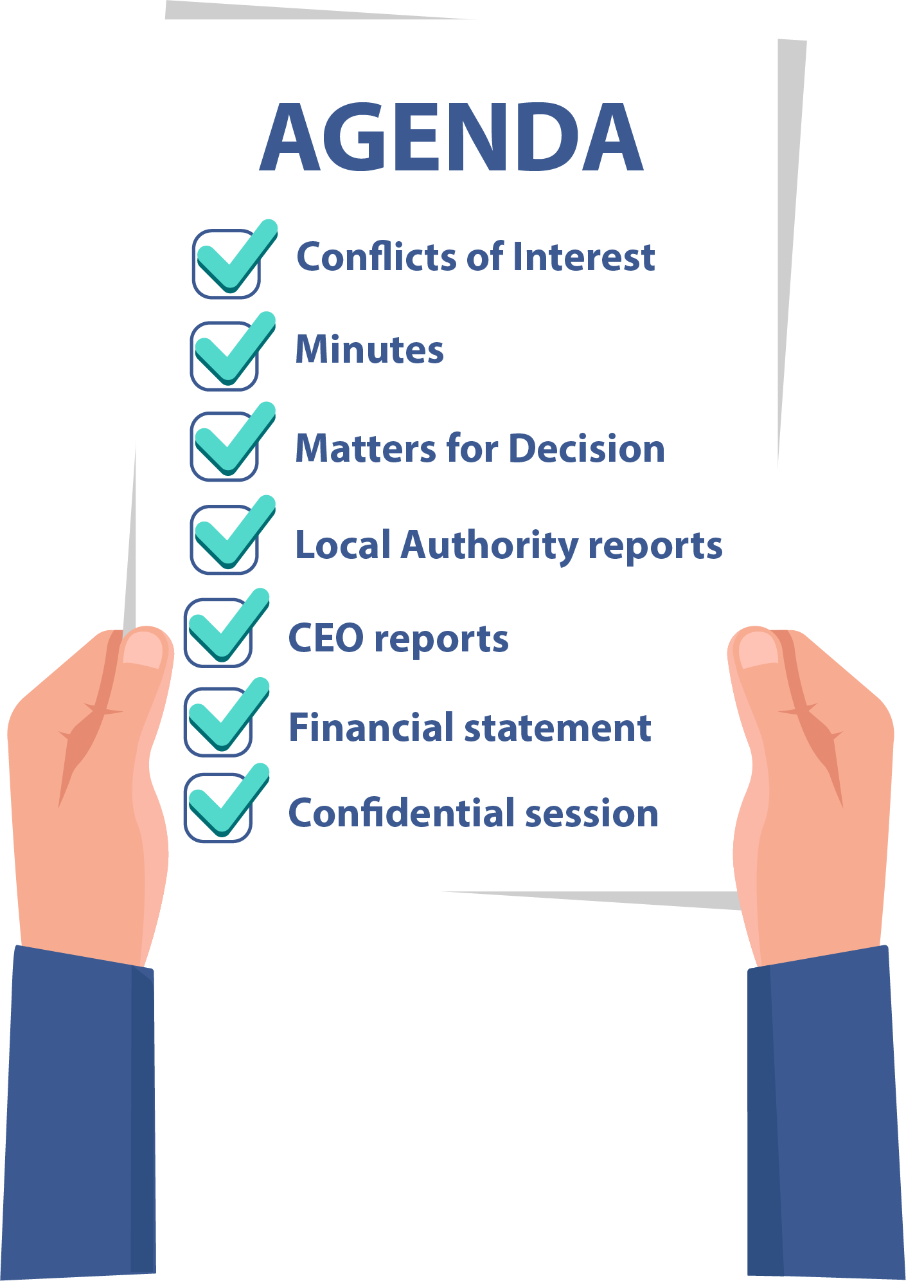
What happens at a council meeting?
The Mayor or President will chair the council meeting and will go through the agenda items.
The council would usually first discuss matters that need a decision.
Then council would consider any reports from local authorities, council officers, and the CEO, as well as the finance report.
Notes:
Examples matters for decision – use council’s agenda papers
Your agenda is like a roadmap and it is important that you keep on track

Slide 12

The role of the chairperson
The chair is usually the Mayor or President.
The chair is responsible for the conduct of meetings and to make sure:
There is good and timely information from the CEO and council officers to inform decisions.
There is enough time for decisions to be made.
That decisions are recorded in the minutes.
That the meeting does not go off track.
That everyone has an opportunity to be heard.
That meetings are respectful.
Notes:
What happens if the Chair doesn’t do their role? How can councillors support the chair in their role? The Chair and the CEO – roles and managing these.
Handout – what makes a good meeting

Slide 13

Ordinary meetings vs special meetings

Slide 14

Ordinary meetings or special meetings
Ordinary meetings may deal with business of any kind, or business as usual, but a special meeting can only deal with the specific business the meeting was called for.
Notices of special meetings must be published and provided to members at least 4 hours before the time of the meeting.
A special meeting may be in response to an emergency situation or urgent matters that need to be resolved as soon as possible.
Notes:
What are the sorts of things that could be a reason to have a special meeting?
Examples of special meetings include cyclone preparation or COVID19 measures or meetings about complex issues or issues that need more time such as recruiting and reviewing a CEO.
The CEO must convene a special meeting if the Mayor/President or 3 or more other members request it in writing or the council resolves to hold a special meeting.
The special meeting will only deal with the business of that meeting unless all members are present and they unanimously decide to deal with other business.

Slide 15



Decision making

Slide 16

Teamwork and diversity
The council works together as a group and so all councillors should respect different ways of communicating and making decisions.
Every councillor will bring their views and ideas to the council and their knowledge of what is happening in their community.
A diverse range of views contributes to better and more inclusive decisions.
Notes:
The Chair should make sure that everyone has had an opportunity to express their view.
Council members should also think about how they behave in council meetings and if it is affecting other councillors.
The Code of Conduct requires courtesy, respect for cultural diversity and culture and prohibits bullying. The behaviour of council members at meetings should set the standard for council and community.
Handout on rules of engagement here

Slide 17

Making decisions
Where a matter requires the council to make a decision, the council might decide to vote on the recommendation provided in the agenda paper or put up its own recommendation for voting.
Councillors must either vote for or against a
recommendation, it is not an option to abstain or not vote.
Councillors might also decide that a matter be deferred or
put off so that more information or other options are provided.
Each decision of a council is recorded in the minutes.
Notes:
Councillors can put forward their recommendations, sometimes called a motion, A motion is a proposal or idea for potential action or decision. ‘Moving’ a motion simply means someone puts the proposal forward to be voted on. Usually this is written down. Then people vote on it.
The chair should make sure that:
Members understand the decision that is being made and have voted on the decision; and
The decision is clear for the minute taker to record.
The minutes of the meeting are circulated to the Council so that councillors can check that the decision is recorded properly.
Resolution eg – The existing road will be repaired. Alternative solution – existing road always gets flooded so if we have enough money to spend on roads let’s resolve to build the new road in a higher place.

Slide 18
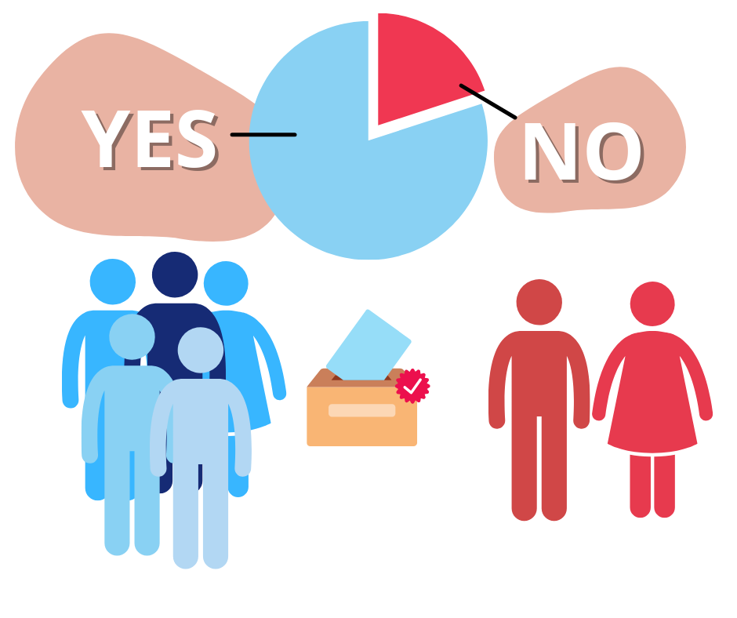
Voting at meetings
When there are enough council members at the meeting to make decisions, this is called a “quorum”. A quorum for council meetings is the majority of council members.
Council decisions are taken when a majority of members present at the meeting vote for or against.
Each member has one vote, but some councils may have a policy that allows the chair a deciding vote if the vote is even.
Notes:
The quorum must be present during the whole meeting. If a quorum is lost during the meeting, then decisions cannot be made. People can continue to discuss issues and share information, but they cannot make official decisions. So it is important that members attend meetings, are on time and stay for the whole meeting, or give notice if they can’t attend.

Slide 19

Council committees

Slide 20
Council committees
The council must create an audit committee to oversee financial management.
A council may also create committees for particular functions, such as environment and waste management, arts and culture, youth advisory, parks and sports facilities.
Council committees can include persons who are not members of the council.
All committees must have terms of reference (what its purpose is and what it will do) approved by the Council.
All committees report to the council.
Notes:
Regional councils who only meet once every 2 months must also have a Finance Committee to monitor financial reports in the month that council does not meet.
A committee does not make decisions on its own, it is part of council and comes back to council with recommendations.

Slide 21

Resources
For more information, view the following resources:
The Local Government Act 2019 at chapter 6 covers council meetings and procedures and at part 5.2 covers council committees.

Slide 22

Quiz

Slide 23

1. How often must council meetings be held?
  Every month
  Only when there is business to consider
  At least every 2 months
  3 times a year
Correct. The first council meeting should be held within 21 days of the election and then councils should meet at least every 2 months. Most councils meet every month and have an information session/briefing before the meeting to go through the papers.

Slide 24
2. Who calls a council meeting?
  The Chair
  The CEO
  Council members
Correct. The CEO calls the council meeting.

Slide 25
3. What should a notice of meeting contain?
(select all that apply)
  Date, time and place of meeting
  The agenda
  Agenda or business papers to be considered at the meeting
  Details of conflicts of interest
Correct. The date, time and place of meeting and the agenda are most important. The notice of meeting might also contain papers to be considered at the meeting. Usually conflicts of interests would be dealt with at the meeting and would appear in the minutes, however if you have a conflict of interest then it is good to raise it with the CEO before the meeting.

Slide 26
4. How much notice is required for an ordinary meeting of council?
  A week
  A month
  3 business days
  4 hours
Correct. 3 business days notice is required for an ordinary meeting. For a special meeting only 4 hours’ notice is required although the more notice that is provided the better it is for council to prepare for the meeting.

Slide 27
5. A special meeting of council can only deal with the specific business it is called for.
  Yes
  No
Correct. Special meetings are unusual and so only deal with urgent or special matters. Usually the general business of council would be dealt with at ordinary meetings.

Slide 28
6. What is a quorum (the minimum number of members required for a council meeting to conduct business)?
  Two-thirds of the members
  All of the members
  The majority of members
  The chair and one other member
Correct. For a meeting to conduct business a majority of members have to be in attendance. If you have 10 councillors a quorum would be 6 councillors.

Slide 29
7. A decision is carried or made by council if it is:
  Supported by all members
  Passed by a majority of members present
  Supported by the chair only
  Passed by two thirds of the members
Correct. A decision is passed when a majority of the members at the meeting support it. If a decision is made by council all members must stand up for that decision even if they argued against it in the council meeting.

Slide 30
8. It is important that all council members have their say but the council acts together as a group to make decisions.
  Yes
  No
Correct. The council members all have responsibility for working together, promoting the decisions of the council, and ensuring good working relationships between the council, residents and organisations in the council area.

Slide 31
9. The chair of the meeting:
(select all that apply)
  Ensures there is good information from management to help council make decisions
  Ensures that everyone has an opportunity to be heard
  Assumes that if members don’t speak they don’t have a view
  Encourages respectful behaviour, in line with the code of conduct
Correct. The chair is responsible for chairing council meetings, supporting good decision making, ensuring all views are considered, and that behaviour is respectful. The Chair should encourage everyone to express a view.

Slide 32
10. Council meetings are open to the public:
  Yes
  No
Correct. Council meetings are open to the public so that people can see the decisions being made, however the public may be excluded while confidential business is considered.

Slide 33
Thank you
We appreciate you taking part in this course.
Please let us know what you thought by completing the feedback form.
Graphics sourced from envato elements and canva pro with appropriate licenses.

