Slide 1



DEPARTMENT OF THE CHIEF MINISTER AND CABINET
Introduction to Council Finances
Elected member course
cmc.nt.gov.au

Slide 2


Course overview
What is a budget and why is it important?
What is in a council’s financial plan?
What to look for in the financial reports?
What will help keep council finances on track?

Slide 3
Council finances overview
The council is responsible for monitoring council finances.
This means making sure the council has enough money to provide services to the community and pay its staff and is spending money according to council priorities.
The council oversees finances. The CEO and council staff manage the finances.

Slide 4
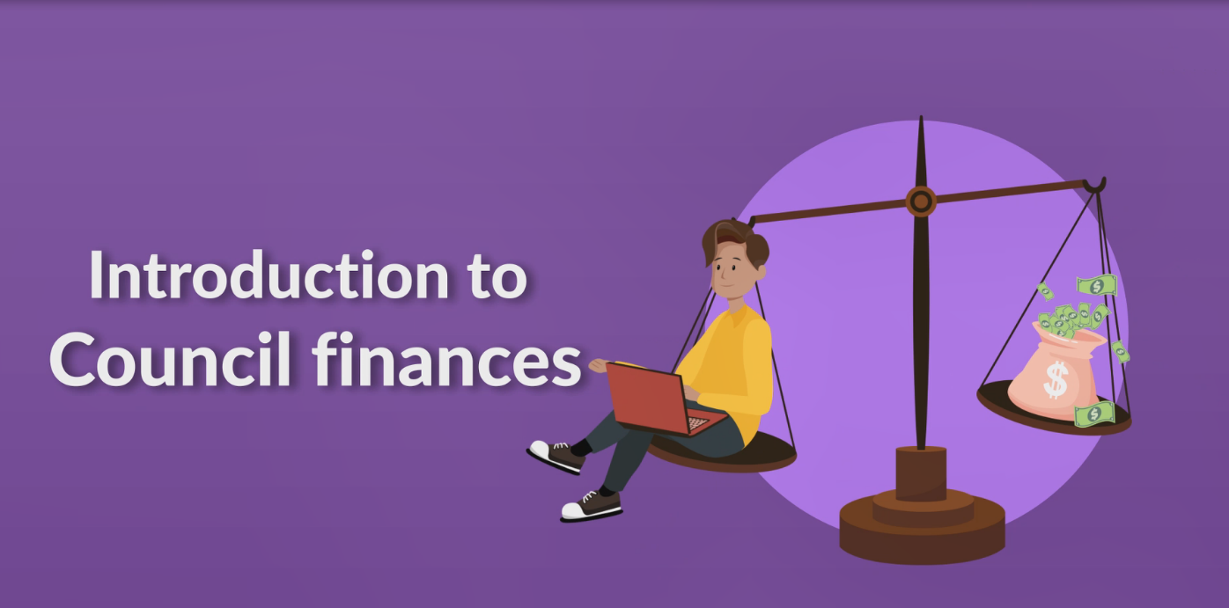

Video introduction
Intro to Council Finances – YouTube
Notes:
https://www.youtube.com/watch?v=fi3ol25oPRE

Slide 5

The Budget

Slide 6

What is a Budget?
A budget is telling your money where to go, instead of wondering where it went.
The council sets the budget for the year.
A budget is a plan (or estimate) of how much money the council expects to receive and spend.
Notes:
Quote Dave Ramsey

Slide 7
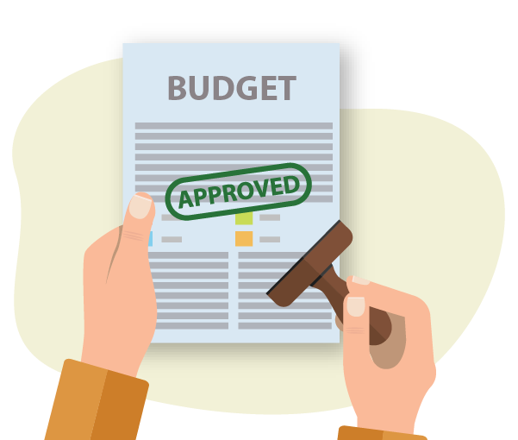
What is council’s role in the budget process?
When considering the budget, the council must:
Make sure there is money in the budget set aside for council priorities, as well as providing for business as usual.
Make sure that money going out will not exceed money coming in.*
Review the budget at least twice a year.
Finalise and approve the annual budget before
30 June each year.
Notes:
It is important to have money in the bank as there will always be bills and wages to pay, this is the business as usual. And then there are the projects and priorities in your regional plan and financial plan to make sure you have money for.
There is also some money that can only be spent on certain things, this is called tied funding. For example, the road grant can only be spent on roads. Council should ensure that this money is kept separate and only spent on those things. If you start dipping into this money for other things then the council will be in trouble.
The Act at s202 states the Council should not budget for a deficit – however this may be allowed where the deficit is to do with depreciation, amortisation, asset write-downs, expenditure of tied grant funding recorded as income in a prior year, any non-cash item.
Sometimes changes are required – additional grants come in, savings are made, priorities change, eg COVID 19 provisions. The Council is required to review the budget twice during the financial year and make any necessary amendments – this might also require reviewing the financial plan.

Slide 8
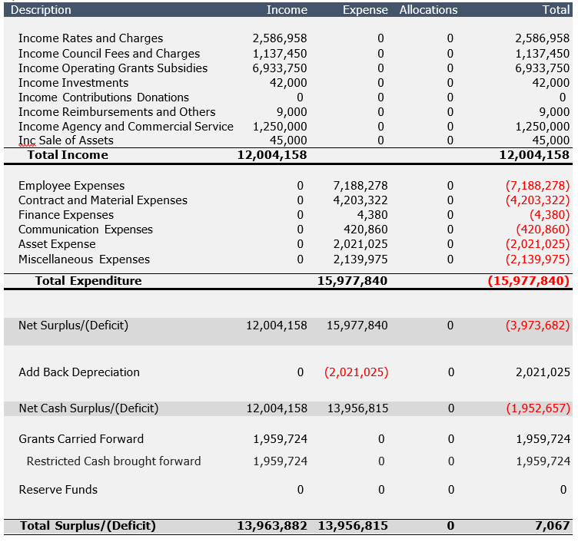
Example budget
A budget shows what the priorities are for council and how much money should be spent on them.
A budget is important because you can check the financial reports against it during the year to see if you are on track.
Notes:
Handout – Council budget

Slide 9

How does council monitor the budget?
The council will consider the financial report at every council meeting. Council’s role is to ensure that the money spent and money coming in is on track.
If there is a big difference between the amounts in the financial reports and the amounts in the budget (this is called the variance) this should be explained in the financial reports and councillors should ask questions to understand why.
Notes:
If councils meet every two months then the Finance Committee will check the financial reports in the month between meetings.
Variance is the difference between what you spent and what you expected to spend.

Slide 10

The financial plan

Slide 11

A financial plan
A council must prepare a Long Term Financial Plan that covers at least four financial years.
A Long Term Financial Plan must contain:
A statement of major initiatives, priorities or activities that the council will spend money on.
A statement of what the council is likely to spend and likely to receive over four years.
Notes:
The four year plan might include major things that can’t be completed in a year such as major roadworks or setting up aged care accommodation.

Slide 12

Checking on money matters

Slide 13


Understanding the information
If you are not used to reading financial reports, ask the CEO to explain the information in the reports or to present the information in a different way.

Slide 14

Financial Reports – Understanding the Information

Slide 15

Income and Expenditure Statement
Income is money that has come in or is expected.
Expenditure is money going out or money that is owed.
It will show if the council has made a profit (surplus) or a loss (deficit) and variance/difference against the budget.
Notes:
If the council is in deficit you should ask the CEO why?
Income and expenditure is sometimes called a profit and loss statement.
Surplus is like a profit or savings – you have money in your hand.
Deficit is when you owe money. It is when the statement is in negative.

Slide 16
Example Income and Expenditure Report
OPERATING INCOME
 | Actual YTD | Budget YTD | Variance | %
Rates | $ 100,000.00 | $200,000.00 | -$100,000.00 | 50%
Fees and charges | $ 50,000.00 | $ 20,000.00 | $ 30,000.00 | 250%
Grants | $ 500,000.00 | $600,000.00 | -$100,000.00 | 83%
Interest income | $ 5,000.00 | $ 5,000.00 | $ - | 100%
TOTAL OPERATING INCOME | $ 655,000.00 | $825,000.00 | -$170,000.00 | 79%
OPERATING EXPENSES
Employee expenses | $ 300,000.00 | $200,000.00 | $ 100,000.00 | 150%
Lease expenses | $ 50,000.00 | $ 50,000.00 | $ - | 100%
Telephone and IT | $ 10,000.00 | $ 10,000.00 | $ - | 100%
Motor vehicle expenses | $ 3,000.00 | $ 3,000.00 | $ - | 100%
Materials and contracts | $ 100,000.00 | $ 50,000.00 | $ 50,000.00 | 200%
Elected member allowances | $ 5,000.00 | $ 5,000.00 | $ - | 100%
Local authority allowances | $ - | $ 2,000.00 | -$ 2,000.00 | 0%
Interest expenses | $ 3,000.00 | $ 3,000.00 | $ - | 100%
TOTAL OPERATING EXPENSES | $ 471,000.00 | $323,000.00 | $ 152,000.00 | 146%
OPERATING SURPLUS/DEFICIT (Income - Expenses) | $ 184,000.00 | $502,000.00 | -$318,000.00 | 273%
ABC Council Income (Profit and Loss Statement) for the period ending 31/8/21
Notes:
This is what happened over the last month or two months since Council last met.
In the profit and loss statement example, there are a number of areas which vary or are different from the budget. This is not unusual as it is hard to know exactly when money is coming in and going out.
Early in the year there is likely to be more of a difference (variance).
At the end of the year money received (income) and money spent (expenditure) should line up closely to the budget.
It is important to watch for areas where the income is lower than expected (in this case grants and rates). Sometimes grants are slow to come into the bank. And it may be that people have been given longer to pay their rates because of the impacts of COVID-19, or that they are just late.
It is also important to check if expenses are higher than expected. In this case materials and contracts have gone over the budget but there is often a lot of expenditure early in the year to get things underway. Also we can see employee expenses have gone over the amount expected in the budget – ask why this is so – maybe employees taking a lot of leave in August and leave loading is being paid or blocks of leave are being paid in advance, or it could mean there was a need to pay more overtime to get important projects completed.
Also note that there has been no expenditure for Local Authority allowances this month. Why is this? Does this mean that Local Authorities didn’t meet?
Handout I & E

Slide 17

The balance sheet
The Balance sheet shows:
what council owns, (assets) including cash, buildings and equipment, and
what it owes (liabilities or debts) including people you owe money to and employee holiday pay.
Notes:
The Balance Sheet/Statement of Financial Position shows what council owns, (assets) including cash, buildings and equipment, and what it owes (liabilities). If you take away the liabilities from the assets then you can see what the council is worth or its financial position (equity).
Having assets is good but if you don’t have money in the bank to pay the bills you might have to sell your assets and that is not always easy.

Slide 18
Balance Sheet: Example
 | Year to Date (YTD) $
ASSETS
CURRENT ASSETS
Cash at bank | $ 4,184,000.00
Term deposit | $ 1,000,000.00
Accounts receivable/debtors | $ 500,000.00
TOTAL CURRENT ASSETS | $ 5,684,000.00
NON-CURRENT ASSETS
Property, plant and equipment | $ 10,000,000.00
Motor vehicles | $ 100,000.00
TOTAL NON-CURRENT ASSETS | $ 10,100,000.00
TOTAL ASSETS | $ 15,784,000.00
LIABILITIES
CURRENT LIABILITIES
Accounts payable/creditors | $ 500,000.00
Payroll liabilities (wages, provision for leave, etc.) | $ 2,000.00
Interest/bank fees | $ 3,000.00
Unexpended grants | $ 4,000,000.00
TOTAL CURRENT LIABILITIES | $ 4,505,000.00
NON-CURRENT LIABILITIES
Finance costs (long term) | $ 10,000.00
Provisions for employee entitlements beyond the next 12 months (redundancy/long service leave) | $ 50,000.00
TOTAL NON-CURRENT LIABILITIES | $ 60,000.00
TOTAL LIABILITIES | $ 4,565,000.00
EQUITY (Total Assets minus total liabilities)
TOTAL EQUITY | $ 11,219,000.00
ABC Council
Balance Sheet
to 31 August 2021
Notes:
This shows council’s overall position at the time of the meeting. It is a snapshot of the position of council. It takes into account not just money coming in and going out, but also the things the council owns or assets (buildings, cars, etc), if it has expenses or interest to do with loans, and also makes provision to make sure it can pay employees entitlements.
The example shows that the council’s financial position is good, as the assets are more than the liabilities, it owns more than it owes. The balance sheet also shows us whether the council has working capital, or money available to keep the council going, which is total current assets ($5 684 000) minus total liabilities ($4 50 5000).
In this case, the working capital is $1 179 000.
And the equity, or the overall financial position of council is +$11 219 000, that is taking all of the liabilities (debts or bills or payments) minus all of the assets (cash money and cars and buildings)
Handouts – balance sheet and navigation tools

Slide 19

Keeping Council finances on track

Slide 20


Keeping money on track
A council that takes responsibility for money matters should:
Have good policies and procedures in place.
Make sure that reports show what money the council has, where the money has gone, and whether council is within budget.
Ask questions.
Make sure that the reports are provided and explained in a way that council members can understand.

Slide 21

Council Audit Committee
The Council must have an audit committee.
The role of the Audit Committee is to:
Monitor and review the integrity of the
council’s financial management:
Monitor and review internal controls
Make recommendations to the council
about issues the council should consider.
The Audit Committee reports and makes recommendations to Council.
Notes:
Part 5.3, s 86 and 87
The Audit Committee looks to ensure strong policies and procedures, clear delegations and grant tracking and reporting are in place to support financial management.
Councils who only meet every 2 months have a Finance Committee as well. The regulations (17) require that financial reports are to be provided to Council monthly and the Finance Committee receives the reports and in the month between council meetings acts as the Council in monitoring the financial position of council.

Slide 22

Safeguards and checks
The following safeguards and checks are in place to make sure council finances are on track:
External audit
Department of Chief Minister and Cabinet
Minister’s rectification order
ICAC
Notes:
External audit - At the end of the financial year an external audit is conducted and the auditors provide their report to council on any concerns and make recommendations about the council’s finances.
Annual fin statements – audited externally and presented to the Minister and NT Grants Commission for review.
CM&C – Accounting records must be maintained and available for inspection, the Department sets out a program of compliance reviews on a rolling basis. s.298
Minister – If there is a problem with the council’s affairs the Minister may write to the Council requiring it to take action to correct the problem (rectification order). s. 214 of the Act.
ICAC – ICAC has broad powers to investigate complaints of misconduct and improper use of funds.
What happens if something goes wrong?

Slide 23

Resources
For more information, view the following resources:
The Local Government Act 2019 at Chapter 10 refers to Financial Management and outlines the procedures required of council in relation to money matters.

Slide 24

Quiz

Slide 25
1. A budget shows:
(Select one)
  The money you have in the bank now
  The money you expect to spend and receive in the next year
  The things you own (assets)
Correct. A budget looks at what money the council is likely to spend and receive in the next year. It is important because it helps the council keep track to make sure that the money expected is coming in and they are not spending too much.

Slide 26
2. Council has a role in:
(Select all that apply)
  Day to day spending
  Approving the budget
  Monitoring the budget
  Approving changes to the budget
Correct. Council must approve the budget and monitor how it is going but council staff are responsible for spending the budget on the operations of council in line with the priorities and programs agreed by council.

Slide 27
3. Council must set out a plan for major projects, income and spending that goes for:
  10 years
  2 years
  At least 4 years
Correct. Council sets out a long term plan for priorities for the council area.

Slide 28
4. What are the main things council members should look for in the financial reports?
(Select all that apply)
  How much money has the council spent?
  What type of computers has the council purchased?
  How much money has the council received?
  Has the council got enough money to pay its debts?
Correct. Council should look at what money has been spent and how much money council has received and check whether this is in line with the budget. Council should also look at whether it will be able to pay for wages, services and goods.

Slide 29
5. An income and expenditure statement shows if the council has made a profit or a loss?
(Select one)
  Yes
  No
Correct. An income and expenditure statement is sometimes called a profit and loss statement and shows what council has spent or has committed to spend, and the monies council has received or expects to receive up to that point in time. The bottom line is that it will show if council is in surplus or deficit.

Slide 30
6. If the council has made a deficit, this is a good thing?
(Select one)
  Yes
  No
Correct. A deficit is a loss and so is not a good thing. Council should try and maintain a surplus.

Slide 31
7. If the council has lots of assets (buildings, equipment, motor cars, graders) the council is in a good position?
(Select one)
  Yes – because those things are worth a lot of money.
  Yes – if it also has enough money to pay its bills.
Correct. Owning lots of things might be good but it doesn’t always mean you can pay the bills. It is important to have assets and equipment but also important to have money in the bank.

Slide 32
8. What is shown on the balance sheet?
(Select one)
  Profit and loss
  It is what the council owes and what the council owns (assets and liabilities)
  Cash coming in and cash going out
Correct. The balance sheet shows the financial position of the council. It takes into account the monies that council owes and takes it away from all the council’s assets and savings. It is what council is worth at a particular point in time.

Slide 33
9. What will support Council to monitor the finances?
(Select all that apply)
  Policies and procedures that support decisions about spending money
  Monitoring by the Audit Committee
  The CEO making all the decisions
  Good reports that show how council is tracking against the budget
Correct. A council handles large amounts of money and so it is important there are rules around who can spend the money, checks to ensure it is not just one person signing off on spending money, and reports to council that members can understand to see how spending is going against the budget. The Audit committee should check on these things and report to the council.

Slide 34
10. The Audit committee of council look over financial management to make sure things are working well. Who do they report to?
(Select one)
  The CEO
  The Council
  The Auditors
Correct. All council committees report to the full council and their recommendations are put to Council for resolution.

Slide 35
Thank you
We appreciate you taking part in this course.
Please let us know what you thought by completing the feedback form.
Graphics sourced from envato elements and canva pro with appropriate licenses.

