Slide 1


Understanding Local Government
DEPARTMENT OF Housing, Local Government and Community Development

Slide 2

Course overview
What is local government?
What do other governments do?
Where does the money come from?
Where can I get support?
How do I get to represent my community?
How do Councils work with Local Authorities?

Slide 3

What is Local
Government?
    https://youtu.be/Z292t18D8Uc

Slide 4

Government for the community
Local Government
provides services and facilities,
plans and implements strategies and priorities; and
brings local concerns to the attention of the Northern Territory and Commonwealth Governments.
Local government’s strength is its ability to take account of, and to respond to, local views and ideas because they are closest to the community.
Notes:
Regional councils in the Northern Territory also have
Local Authorities that support communication between communities and councils.

Slide 5
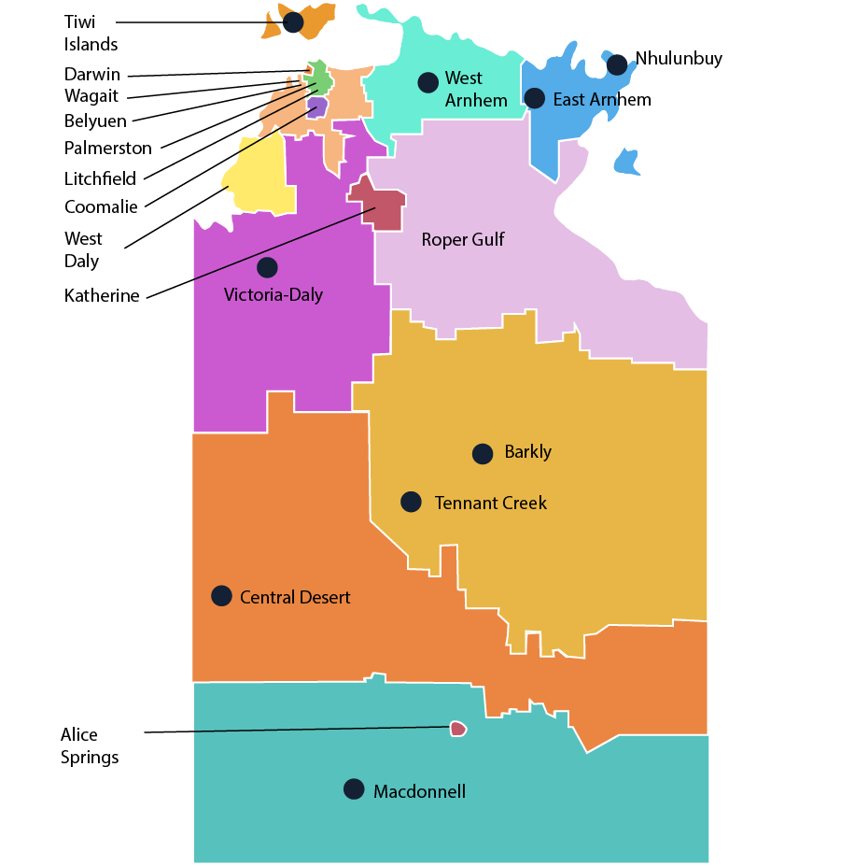


Local Government in the NT
In the Northern Territory, there are 17 councils and 3 types of local government:
5 Municipal Councils
3 Shire Councils
9 Regional Councils

Slide 6


Roles and Responsibilities of the different governments

Slide 7
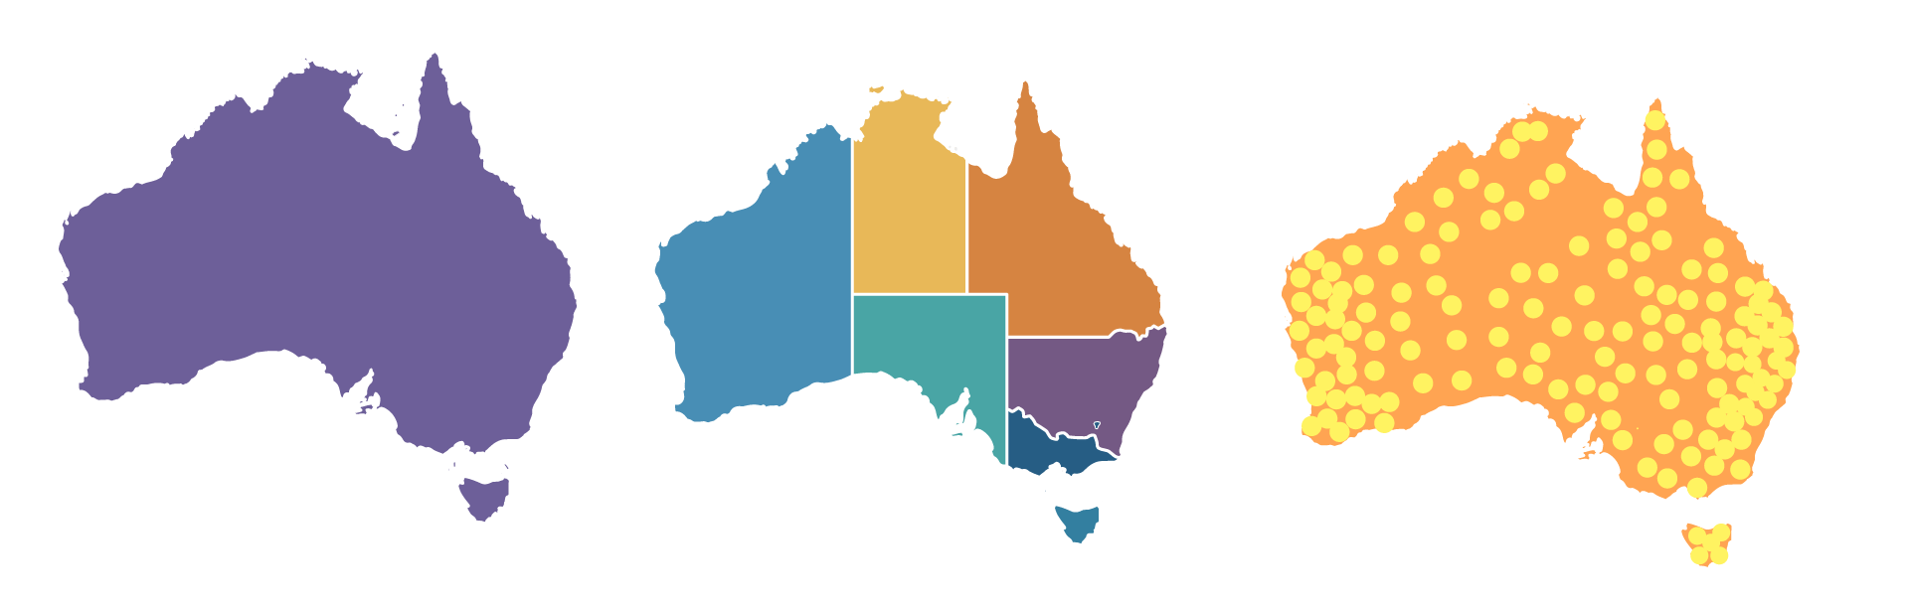
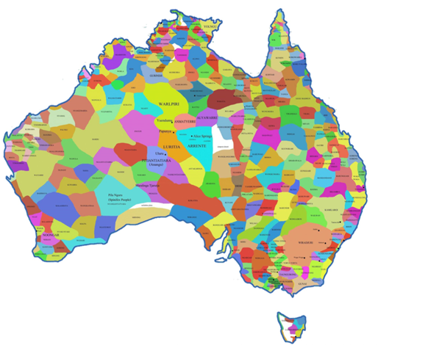
How does local government fit into the structure of government in Australia?
There are 3 spheres of government.
Aboriginal
Governance
Federal or Commonwealth Government
State or Territory Government
Local Government
Notes:
First there was 100s of nations across Australia, with their own rules and customs and often their own languages. After 1788, colonies were formed that were still under the control of Britain.
These colonies, WA, SA,Tas, QLD, NSW and Vic Australia came together to form the Federation of States. This means they gave up some of their powers in order to have a national government, also known as the Federal or Commonwealth Government.
The Constitution states what powers the Commonwealth has and the rest stayed with the States.
Local Government is created by laws of a State or Territory and so its role differs slightly between states and territories.

Slide 8

Federal/Commonwealth government
Post and
telecommunications
Immigration
Defence
Foreign affairs and
trade
Taxation
Aboriginal affairs
Native title
Social services/welfare
Federal or Commonwealth Government
Notes:
The role of the Commonwealth Government is set out in the constitution. For example the Aboriginal Land Rights Act is a Commonwealth law, even though it is only about the NT. This is because the constitution says that the Commonwealth is responsible for Aboriginal Affairs. The Commonwealth created ATSIC and runs CDP because of this.

Slide 9
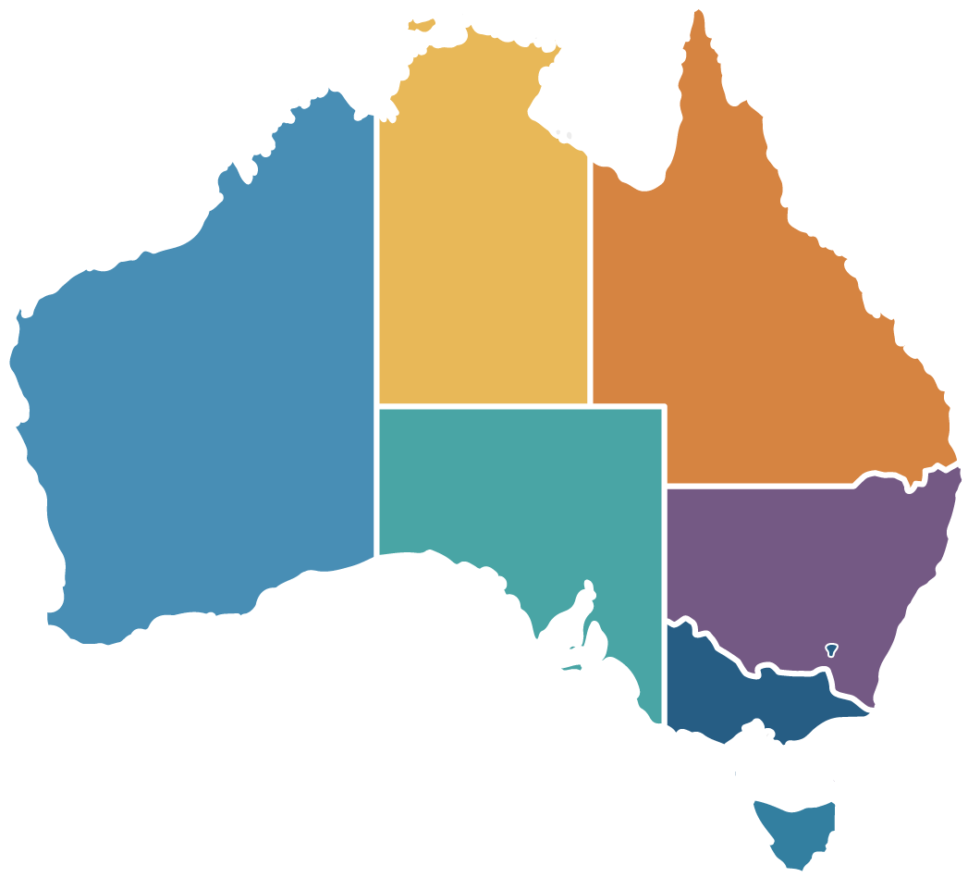
State and Territory Governments
Hospitals
Schools
Police
Housing
Some main roads
Railways
Arts
Culture
Heritage
Land management and land ownership (non-Aboriginal land)
State and Territory Governments
Notes:
The roles of the different states are set out in their constitutions.

Slide 10


The NT Government is responsible for:
The NT Government is not a State Government but has similar powers and responsibilities.
The role of the NT is set out in the Northern Territory (Self-Government) Act 1978 (Cth).
Notes:
Because the NT government is a territory and not a state it means that the Commonwealth Government can overrule NT law or make laws for the NT. It is unusual that they do so.
The NT finds it hard to raise money with a small population and limited businesses.
Like local government it relies on the Commonwealth for the bulk of its funding to enable it to deliver services.

Slide 11
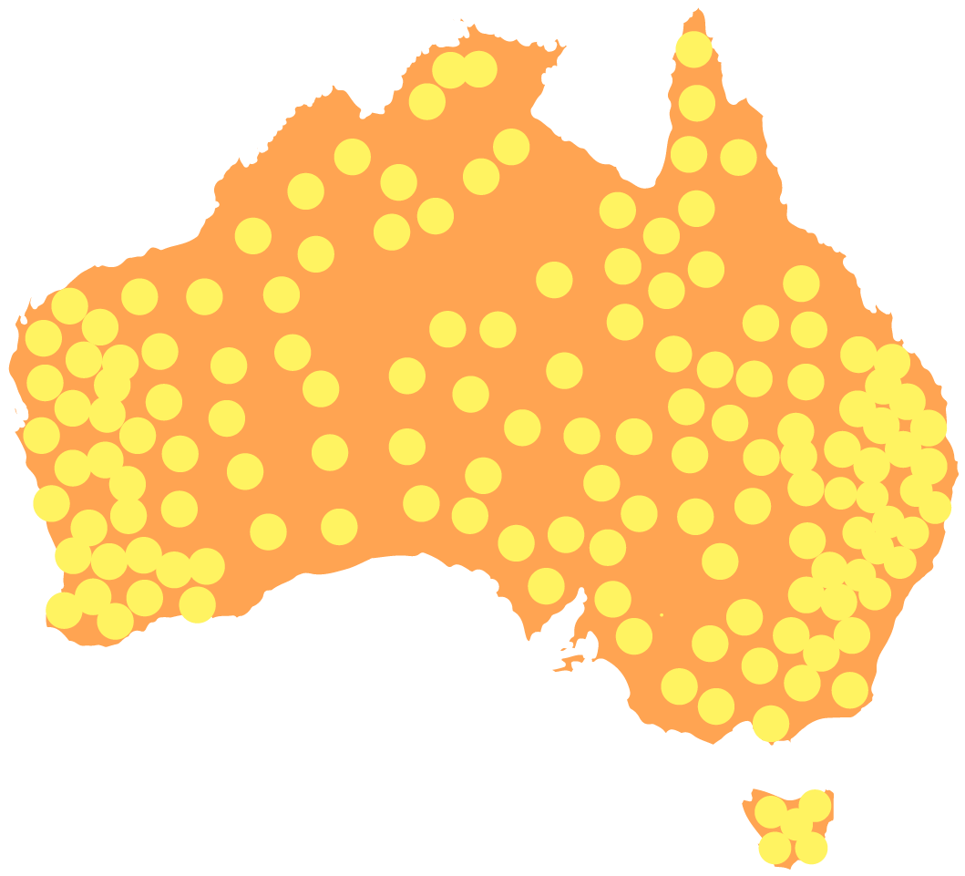
Local Governments
Local roads
Waste management
Environmental infrastructure and programs
Street lighting
Libraries
Public toilets
Parks and gardens
Community programs such as youth, aged care, child care and early childhood programs.
Notes:
Local Government is the level of government closest to the community it serves and is the most trusted form of government.
The role of local governments may differ as Local Governments are created by laws made by the states and territories. In the NT that is the Local Government Act 2019. It is often referred to as roads, rates, rubbish but is a whole lot more.

Slide 12

Who does what?
It all seems so clear….. But is it?
Notes:
So we have got our handouts in front of us and we should be able to work out who does what by just having a look at these. (or reading the Constitution)

Slide 13
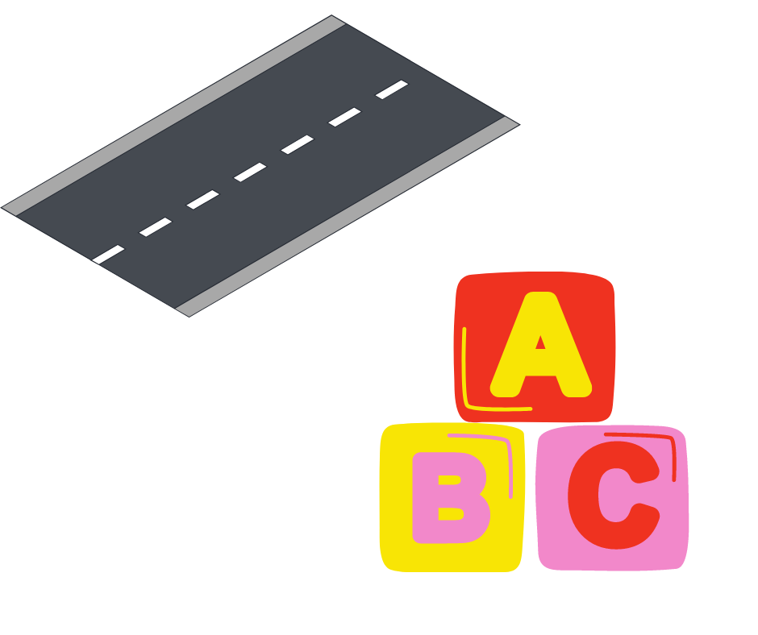
Overlaps and gaps
There is sometimes confusion about roles, they might overlap or there might be gaps where no-one is taking responsibility.
For example:
Roads might be the responsibility of the Commonwealth, NT or local government or even the homeland. It is often hard to know which is which.
Early childhood centres could be funded by Commonwealth (private), NTG or council.
Notes:
Commonwealth subsidises private centres (where there is a market). NTG run Child and Family Centres (with funds from Commonwealth) and Families as First Teachers. Councils often run early childhood centres and programs (often when there are no other services). Community organisations used to run Budget Based Funding services but many of them closed because of the rules around qualifications and minimum staffing.

Slide 14

Changes in roles
Roles can also change from time to time.
For example:
States and Territories used to be responsible for Disability Services but they contributed money to the Federal Government to run NDIS. Local Government still provides disability support, often where there are no other services.
Notes:
And sometimes roles and responsibilities transfer across without it being clear and without resources attached. These may end up with local government as a provider of last resort.
Homelands were a responsibility of the Commonwealth Government, however they handed over the responsibility to the NT government and other State and Territory governments with a small bucket of money. There has been arguing about this for a long time because the homelands were handed over in a poor state because not much maintenance had been done and the money was not enough for new houses and to fix up the old ones. Councillors often ask “Who do we go to about homelands?” It is not the role of the council but Council can provide information about their homeland needs and go and talk to Federal and NT governments.

Slide 15
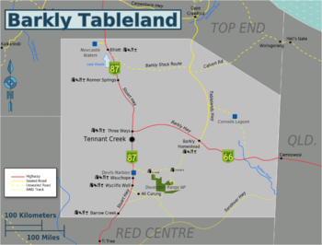
Collaboration and coordination
And when things work well, roles and responsibilities are coordinated so services and infrastructure work together and complement each other.
For example:
The Barkly Regional Deal brings together Commonwealth, NT and Local Governments to work together under a community governance model to improve outcomes for the region.
This Photo by Unknown Author is licensed under CC BY-SA
Notes:
Unfortunately things got off track with the Barkly Regional Deal. The council was meant to deliver some things and keep track of the money separately but this did not happen. This affected our relationship with the other partners in the BRD. The investigation report recommends an audit to sort these things out.

Slide 16

Money matters

Slide 17












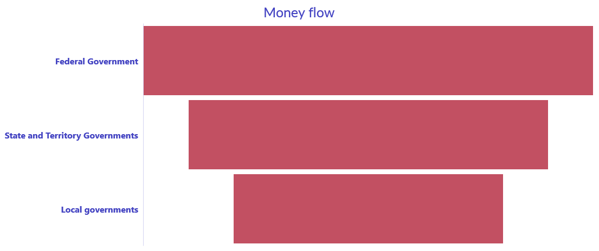
Where does the money come from?
FFA
Notes:
The Commonwealth Government takes in the most money and then provides grants and funding to the States/Territories and Local Government. All governments also raise some money through fees and charges. The money coming down is a bit like a slow drip and there is not always a lot left when it gets to the bottom.
State and Federal governments have the power to raise
and collect taxes and use that money to carry out their responsibilities.
However the state governments gave up income tax (the tax on people’s pay) to the Commonwealth. In return, they receive a distribution of money raised through the goods and services tax (GST), and grant funding such as
Federal Funding Agreements . FFAs are in areas like Health, Education, Closing the Gap.
Local governments raise money through property rates and fees and
charges for services. Rates are paid by all property owners and pooled to help pay for services and infrastructure and so in this way they are a bit like a tax.
However most councils in the NT, particularly
those in regional areas, are reliant on NT and federal government
grants for the majority of their funding.

Slide 18

Support and guidance

Slide 19

Support for Local Government
The NT Government seeks funding from the Commonwealth government for local government, and also provides its own additional funding programs.
The Department of Housing, Local Government and Community Development provides information, training, advice and assistance to councils.
Notes:
The NT Government makes recommendations for the allocation of funding from the Commonwealth through the NT Grants Commission, which is a major source of funding for local government.
The Department of Housing, Local Government and Community Development provides advice and the Regional Officers provide support on the ground.

Slide 20


The NT Government regulates local government
The NT Government is also responsible for making sure that councils comply with the law and the principles of good governance, including management of their money.
The Local Government Act 2019 sets out the rules and standards for local governments to follow.
Notes:
The Department has a difficult role because we are there to support you but are also the police officer for local government and provide funding to local government.
LGANT also provides support and assistance to local government. They are the representative or the union for local government.

Slide 21

Representing your community

Slide 22

Representation
People nominate for council because they have ideas, interests and experience that they think will benefit the community. People often represent different views or are seeking change.
Once a person is elected to council, the council come together as a group to make decisions. The council together represents all the people in their council area.
Notes:
The council makes decisions together. This is one of the problems of the previous council. They argued and couldn’t find a way forward. And a lot of the time they only heard a few voices While it is ok to disagree, you have to come to a decision and once the decision is made, that’s it, everyone has to go by that decision.

Slide 23

Local Government Elections
Council elections are held every four years.
A by-election may be held if and when a position becomes vacant.
Council members are elected to represent the interests of all people in their council area (not just their ward or their community).
Notes:
Because the Barkly council was elected within a year of a general election this council gets an extended period until the next general election in August 2029.
However, the Minister has flagged changes for local government and for the Barkly in particular to increase community representation, The Barkly council will have an important role in representing your community in relation to these changes.

Slide 24

Working with Local
Authorities

Slide 25

How do councils and local authorities work together?
Local authorities provide local communities a voice to regional councils.
Councils must work with local authorities to ensure all communities within the region are represented and get to have their say.
Notes:
The investigation report indicated that too much attention was being paid to Tennant Creek and that the priorities of the local authorities were not being properly considered. In particular, council need to revisit the five year infrastructure plan wishlist from each of the local authorities in order to determine priorities for capital expenditure. Hold ups in making decisions by the council saw local authority project funding go unspent. There is a proposal to delegate decision making on the Local Authority Project Fund to avoid delays.
Council engagement with local authorities was criticised – it has been recommended that the Council should establish a meeting circuit to meet in each local authority during the year.

Slide 26

Advice to council
A council must seek advice and recommendations from the local authority about the council’s:
budget
priorities for expenditure
service delivery
regional plans
strategic directions
funding
Notes:
In finalising your budget and regional plans it is important that local authorities are involved in determining what are the priorities. The last regional plan had no input from local authorities.

Slide 27
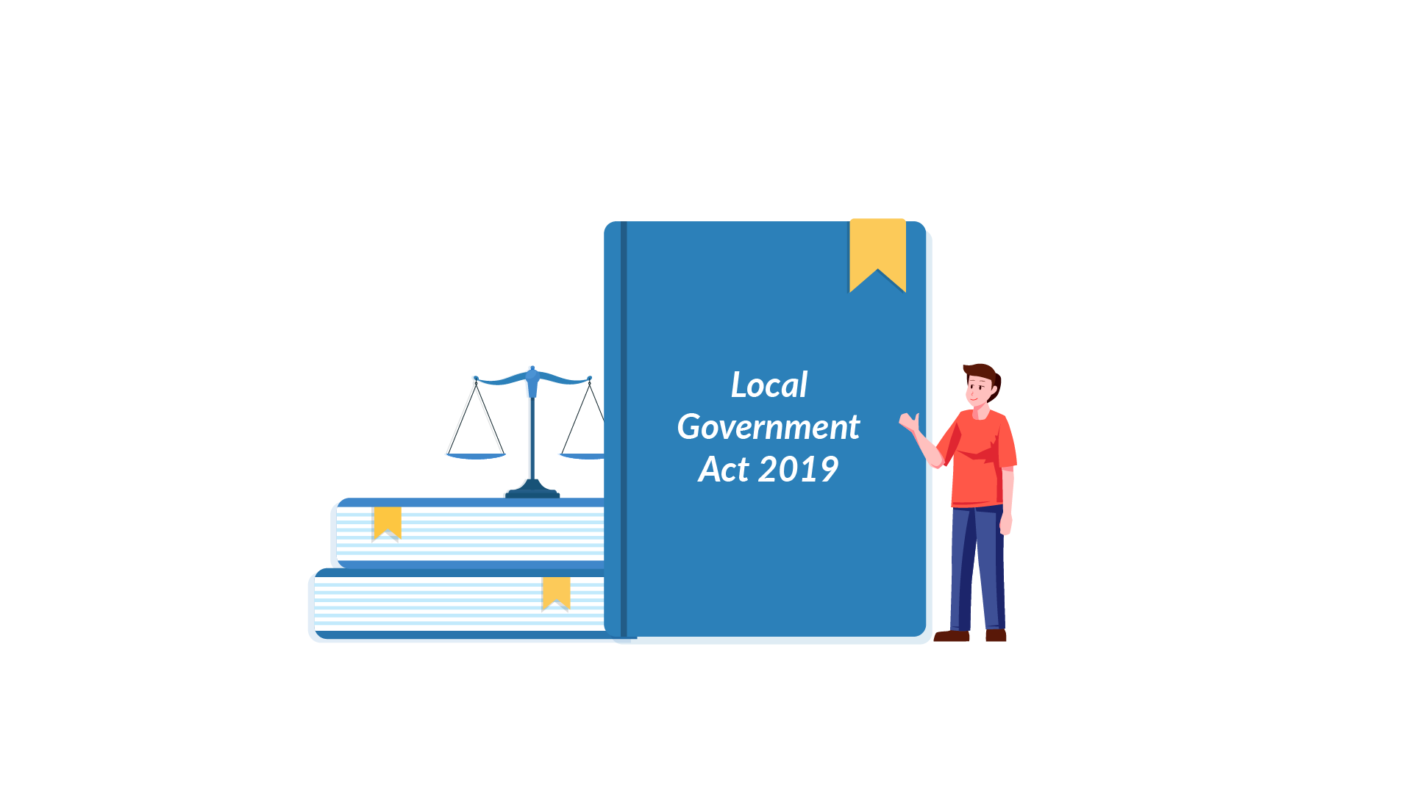
Local Government Act 2019

Slide 28
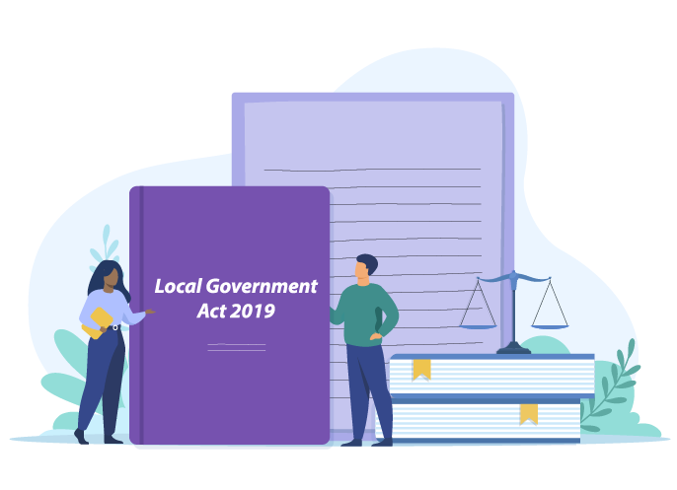
Local Government Act 2019
Councils are bound by the
Local Government Act 2019
The Act sets out the principles for local government councils in the Northern Territory, the roles and responsibilities of council members.
It also sets out the requirements and guidance for carrying out local government functions.

Slide 29

Resources
For more information, view the following resources:
Local government areas – s.15of the Local Government Act 2019
Compliance - Chapter 15 of the Local Government Act 2019
Elections- Chapter 8 of the Local Government Act 2019

Slide 30

Quiz

Slide 31

1. Local government is the government closest to the community:
  Yes
  No
Correct. Local government is based nearest to where people live, in the towns and regions across the country. Local councillors are often people you know and the work of local government is visible around where you live.

Slide 32
2. Local government gets its powers from:
  The Australian Constitution
  The Northern Territory Self-Government Act 1978
  The Northern Territory Constitution
  The Local Government Act 2019 (NT)
Correct. Local government is formed by an act of the NT parliament and its powers and duties are set out in legislation.

Slide 33
3. Which of the following is a role of local government:
  Health
  Telecommunications (phone, internet, etc)
  Rubbish collection
  Railways
Correct. Local government is responsible for rubbish collection. The Federal Government is responsible for phone and internet under the Australian Constitution. The NT government is responsible for health and railways.

Slide 34
4. State/Territory governments are responsible for:
(select all that apply)
  Hospitals
  Schools
  Housing
  Foreign affairs and trade
Correct. State governments are responsible for these areas and the Federal Government is responsible for things that extend beyond the borders of Australia such as foreign affairs and trade.

Slide 35
5. How is local government funded?
(select all that apply)
  Commonwealth grants
  NT Grants
  Rates
  Taxation
Correct. Local government in the NT receives funding from rates (more so for municipal councils) and largely from government grants. Local government can charge fees for services but does not have the power to tax residents in its area (although sometimes people call rates a tax).

Slide 36
6. How often are councils elected?
  Every year
  Every 2 years
  Every 3 years
  Every 4 years
Correct. Local government elections are held every 4 years. If a member resigns or a council position becomes vacant within that four years then a by-election may be held without having to wait for the end of the 4 year term. However, Barkly Regional Council will now hold office until August 2029.

Slide 37
7. Councillors make decisions for:
  The people who voted for them
  The people in their ward
  All the people in the council area
Correct. Each councillor will put forward the views of their local community but once they are elected they represent all the people in their council area.

Slide 38
8. Who should elected members work with?
  Local authorities
  Council
  Council staff
  All of the above
Correct. The council, local authorities and the staff of the council all have responsibility for working together and ensuring good working relationships between the council, residents and organisations in the council area.

Slide 39
9. A council must seek advice and recommendations from the local authority about the council’s:
(select all that apply)
  Budget
  Priorities for expenditure
  Employment of staff
  Strategic directions including the regional plan
Correct. Council needs to work with local authorities in the business of council to ensure local communities are involved in decisions and the development of council priorities and programs. The employment of council staff is up to the CEO.

Slide 40
10. The Northern Territory Local Government Act 2019 sets out:
(select all that apply)
  The principles for local governments
  The roles and responsibilities of council members
  Guidelines to councils for carrying out local government functions
  All of the above
Correct. The Local Government Act provides guidance to councils on how to do their job and the principles and standards that are expected of councils.

Slide 41
Thank you
We appreciate you taking part in this course.
Please let us know what you thought by completing the feedback form.
Graphics sourced from envato elements and canva pro with appropriate licenses.

