Slide 1


Department of THE CHIEF MINISTER & CABINET
Introduction to the Code of Conduct
Local Authority Training 2022/23

Slide 2

Course overview
An understanding of the Code of Conduct
The behaviours expected of local authority members
What happens if a member breaches the Code of Conduct?
Where to find further information?

Slide 3
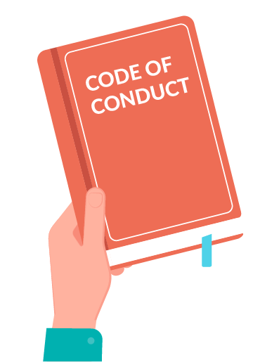
What is the Code of Conduct?
The Code of Conduct sets the values and standards council and Local Authority (LA) members are expected to follow.
It guides behaviour in performing your duties as a LA member.
The Code of Conduct also lets the community know what standards they
can expect from LA members.
Notes:
This means that the Code of Conduct guides the way you should behave and how you behave with others.
There are 12 Standards and we will look at these no

Slide 4

1. Honesty and integrity
The Code of Conduct requires LA members to
behave with honesty and integrity when performing duties.
Honesty and integrity means being truthful and reliable.
When making decisions, make them for the right reasons. Think about what benefits the community the most.
Notes:
Holders of public office must avoid placing themselves under any obligation to people or organisations that might try inappropriately to influence them in their work.
Example -
Local Authority members should act only for their community. They should not act or use decisions for themselves or for their friends or family. They must declare and resolve any interests and relationships.
Example –
They must consider their interests and biases and be open about these in order to ensure decisions are made in the interests of the community as a whole and on the basis of the best available evidence.
Example -

Slide 5

2. Care and diligence
LA members need to act with reasonable care and diligence in performing their duties.
This includes reading the agenda ahead of the local authority meeting so you know what the meeting is all about and considering the information.
It also means taking care in what you say and do as a LA member – particularly be careful on social media.
Notes:
It is also important to take care in relation to personal actions that may reflect on the reputation of the council. Be careful when doing things such as liking posts on social media, particularly if they are not in line with the policies and values of the council.
Example – don’t post stuff on facebook or comment about things violent or abusive things on facebook especially if it has to do with council stuff.

Slide 6

3. Courtesy
Be courteous towards other members, council staff and the community.
You can do this by being polite and respectful, listening to what others have to say, being on time to LA meetings, and being considerate of others.

Slide 7

4. Bullying
As a LA member, you must respect other members and show good behaviour.
The Code of Conduct does not allow bullying, including:
Spreading rumours
Excluding others
Hurtful comments
Threats
Involving family/friends
This also includes online and text bullying, such as:
Sending nasty messages
Disrespectful comments on social media
Prank calls and harassment

Slide 8
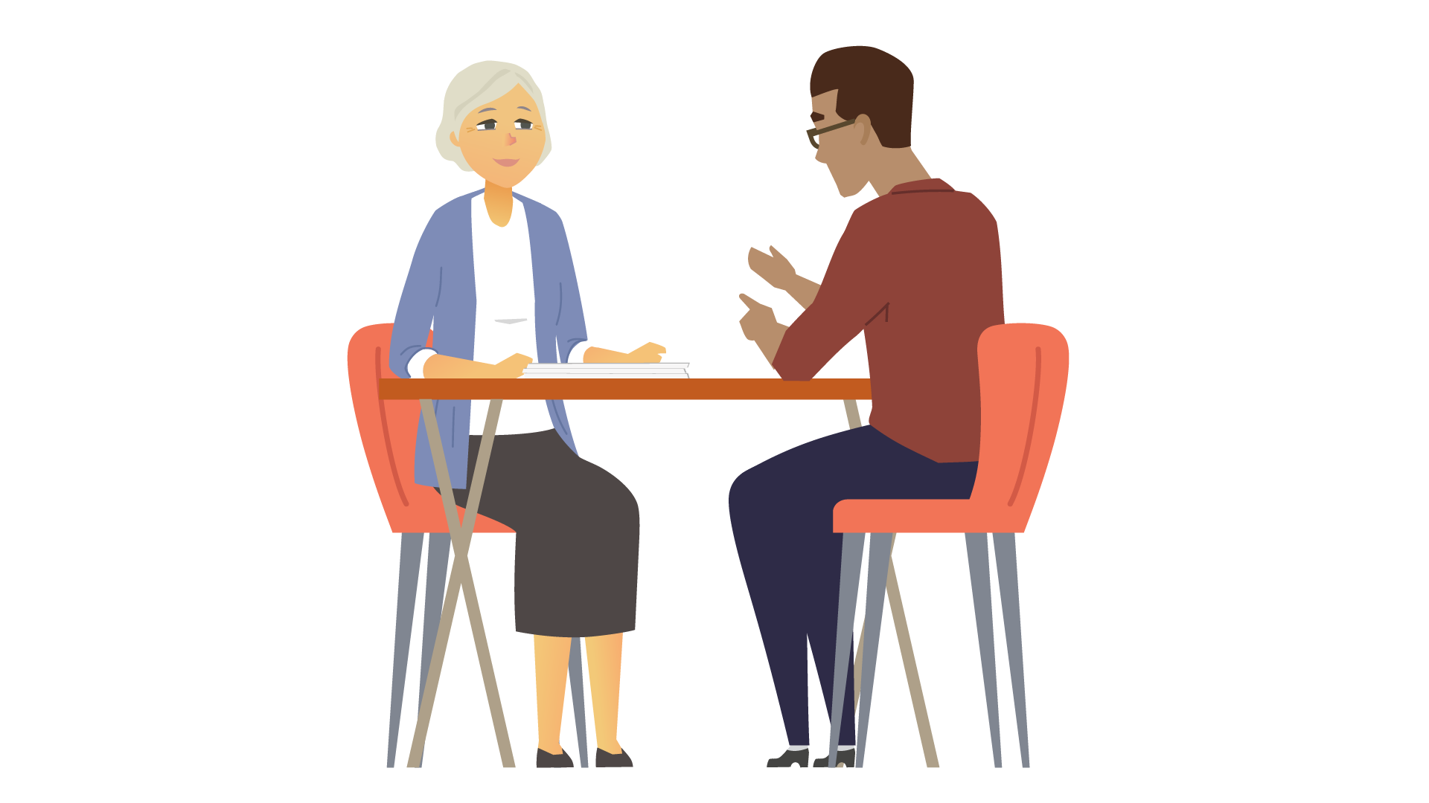
5. Conduct towards council staff
As a LA member, you must not be bossy to council staff.
LA members don’t direct, manage or tell off council staff. For example, a member should not criticise or say something bad about council staff in the LA meetings.
The CEO is responsible for managing council staff, and contractors. If you have an issue in relation to council staff you should talk to the CEO or the Community Service Manager in your area.
Notes:
Local Authorities should be seen to working together with council staff to deliver the best outcomes for the community. Undermining or speaking badly about council and council staff is not good for the council as a whole.
Think about how you work with council and staff members.

Slide 9

6. Respecting cultural diversity
You must always be respectful of other people’s beliefs, culture, and opinions.
You must not discriminate against others because of their cultural background or what mob they are from.
For example, people from different cultures or tribes may use different ways of communicating, or there may be issues that prevent them communicating, such as avoidance relationships.
Notes:
LA members come to the table with different experiences and backgrounds and all of them contribute to better decisions. It is important that different points of view are encouraged rather than just listening to the loudest voices.

Slide 10
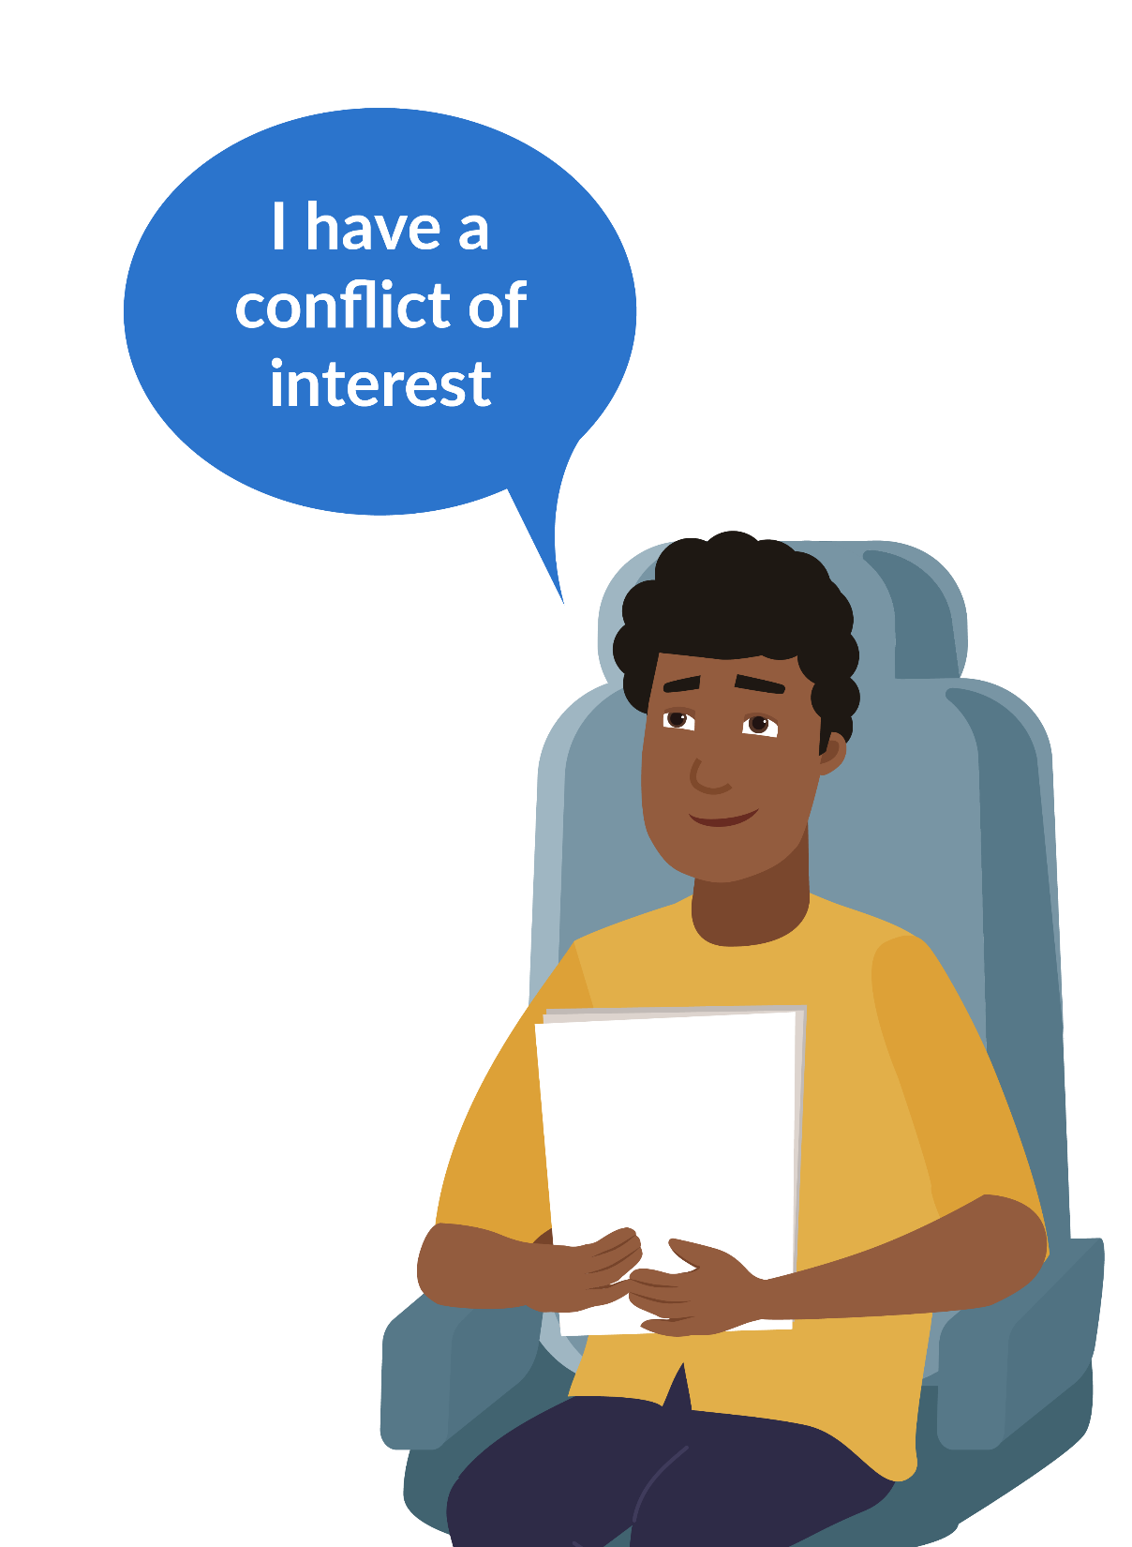
7. Conflict of interest
LA members need to avoid conflicts of interests
This is when your role as a LA member conflicts with another interest that gives you or someone close to you a benefit.
You must speak up if you think you have a conflict of interest.
If you say nothing and participate in Making a decision, you could be in breach of the Local Government Act 2019 and be penalised.

Slide 11
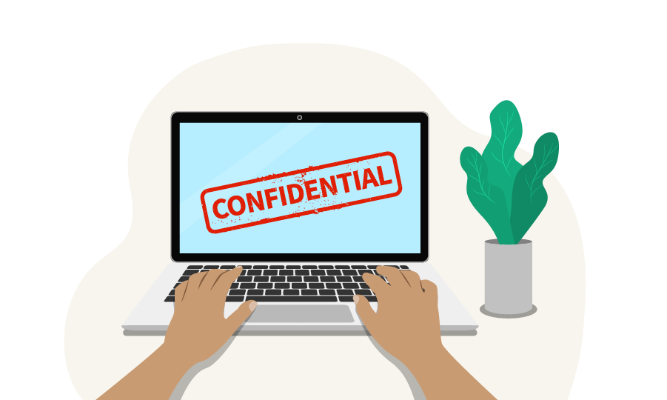
8. Confidential information
As a LA member, you will occasionally receive information that is confidential.
Confidential information must be kept private and not talked about with others who are not part of the confidential session of the meeting.
You must not use confidential information in a way that could give a benefit or cause harm to another person.
Notes:
Confidential information might be private details about staff or community residents, it could be about businesses providing quotes to do work, it could be about contracts and things that should not be made public.

Slide 12

9. Gifts
You must not accept gifts or benefits from someone that might get an advantage from the council or local authority.
This is because it may look like you are biased or giving favours, especially if that person could benefit from or influence a decision.
Look at your Council Gifts policy or talk to the CEO for further information.
If you are unsure ALWAYS ask.
Notes:
Some councils may not allow you to accept any gifts at all and other councils may let you keep a gift if it is less than $50. What does your council policy say?

Slide 13

10. Accountability
LA members have an important role to represent and answer to the community.
LA members should:
talk to people in their community regularly,
talk at local authority meetings about what the community wants, and
keep the community updated about what council is doing.
Notes:
It is important to provide feedback to the community about the local authority and the work of council.

Slide 14

11. Working for all the people in your area
As a LA member, you represent all the people in your local authority area.
When making recommendations, you will need to think how this will affect the whole area and whether this would be in the long-term interests of all community members.

Slide 15

12. Training
If you are offered training, you should do it if it is to help you perform your duties as a LA member.
The Code of Conduct states that you must undertake training in good faith, which means trying to participate in training opportunities when you can.

Slide 16

13. What happens if a local authority member breaches the Code of Conduct?
If someone thinks a local authority member has breached the Code of Conduct, a complaint can be submitted with the CEO of the council.
The council will then make a decision about the complaint.
Notes:
This means if a LA member does something wrong or not right, the council may consider action against them including cancelling their appointment as a LA member .
ICAC also has powers to investigate behaviour including corrupt conduct, misconduct, unsatisfactory conduct, and anti-democratic conduct. There are currently a number of reviews and investigations happening.

Slide 17

Resources
For more information, view the following resources:
Code of Conduct - Schedule 1 of the Local Government Act 2019

