Slide 1

Local Authorities Induction
Key Information
Department of the Chief Minister and Cabinet
Speaker

Slide 2
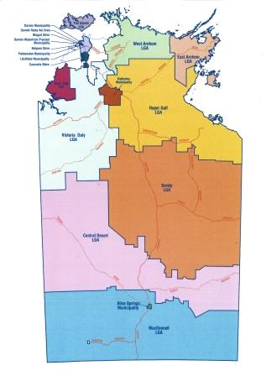
Local Government in the NT
Local Government is the government closest to the community.
Local Government in the NT is formed under, and guided by,
the Local Government Act 2019.
In the Northern Territory local government is comprised of:
  Five municipal councils (such as Darwin and Alice Springs)
  Nine regional councils (predominantly regional or remote areas such as Central Desert or East Arnhem)
  Three shire councils (Belyuen, Coomalie and Wagait).

Slide 3

Role of Council
Council is a public body made up of democratically elected representatives working together to improve the quality of life for people in the Council area.
It represents community interests.
It works as a team to make informed and responsible decisions.
It allocates resources fairly to provide public facilities and services.
Notes:
The role of a council is:
to act as a representative, informed and responsible decision maker in the interests of its constituency;
to represent the interests of its area to the wider community;
to develop a strong and cohesive social life for its residents and allocated resources in a fair, socially inclusive and sustainable way;
to provide and coordinate public facilities and services;
to encourage and develop initiatives for improving quality of life; and
To exercise and perform the powers and functions of local government assigned to the council under the Act or another Act.

Slide 4

Local Authorities
Local authorities provide a voice for communities in regional councils.
Local authorities:
Involve local communities in local government business
Help communities give their opinions on local government business and takes their views to council
Involve local communities in developing policies for their area and contribute to the regional plan
Advocate for communities
Make recommendations to the council about budget allocations for the area.

Slide 5

Councils to work with Local Authorities
Council must seek advice and recommendations from Local Authorities on:
Budget
Priorities for expenditure
Service delivery
Regional plans
Strategic directions
Funding

Slide 6
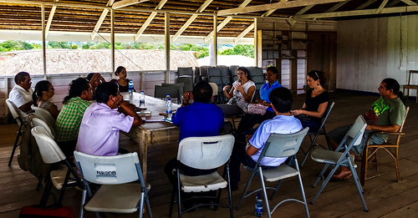
Who is the Local Authority?
A local authority is made up of:
members of the community or communities within the local authority’s area that are appointed by the council; and
at least one council member who is a member of the ward in which the local authority is located.

Slide 7
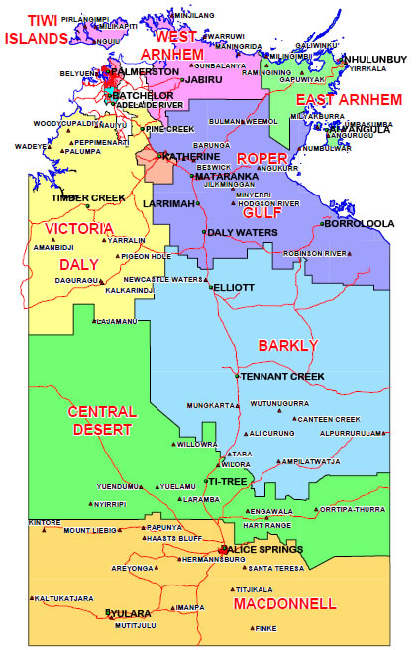
Where are the Local Authorities?
There are currently 67 Local Authorities
Local Authorities are connected with the following regional councils:
Tiwi
Barkly
East Arnhem
West Arnhem
Victoria – Daly
Roper Gulf
MacDonnell
Central Desert

Slide 8
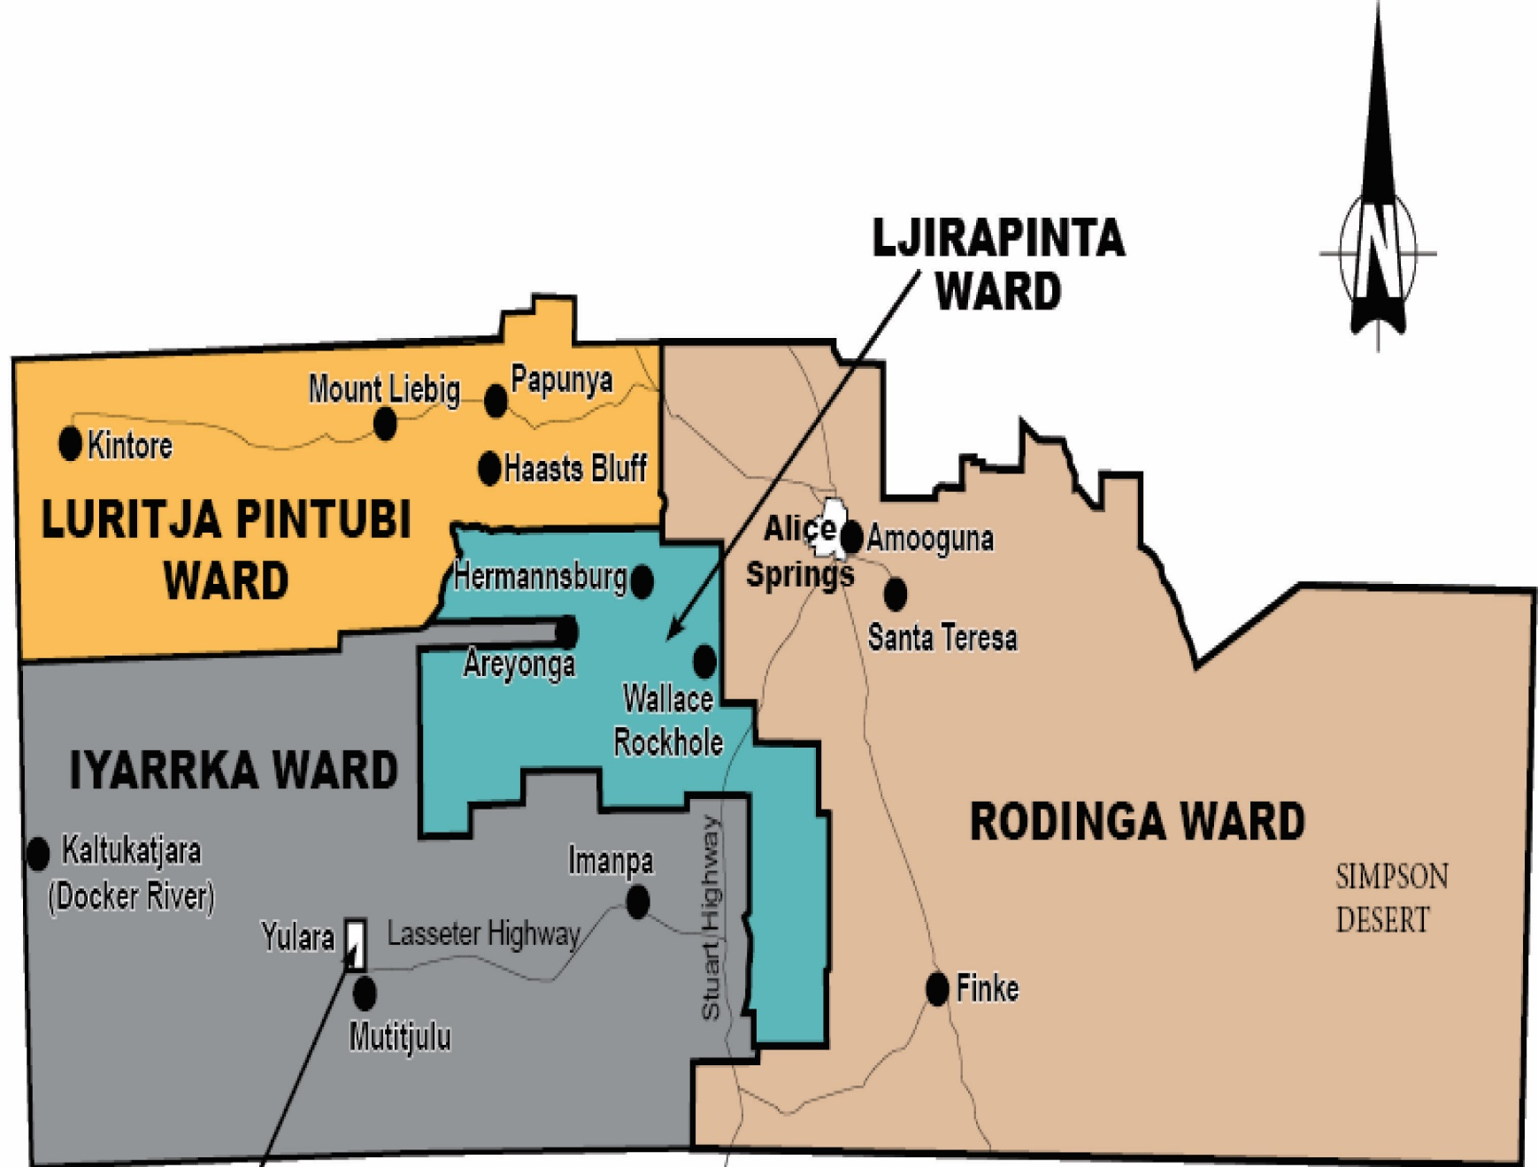
MacDonnell
Note: Yulara is excluded as it is unincorporated.

Slide 9
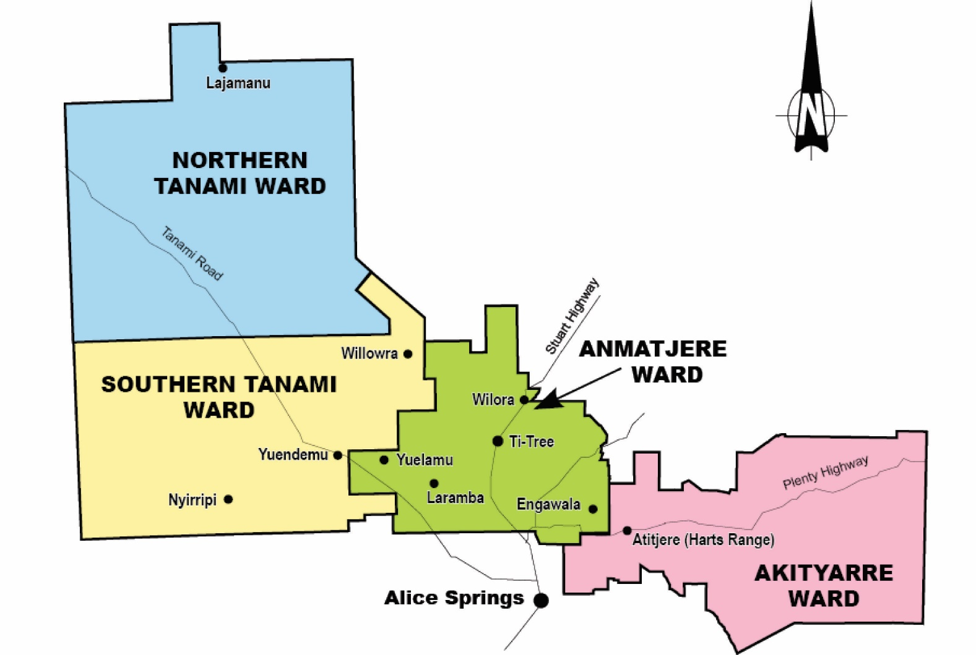
Central Desert

Slide 10
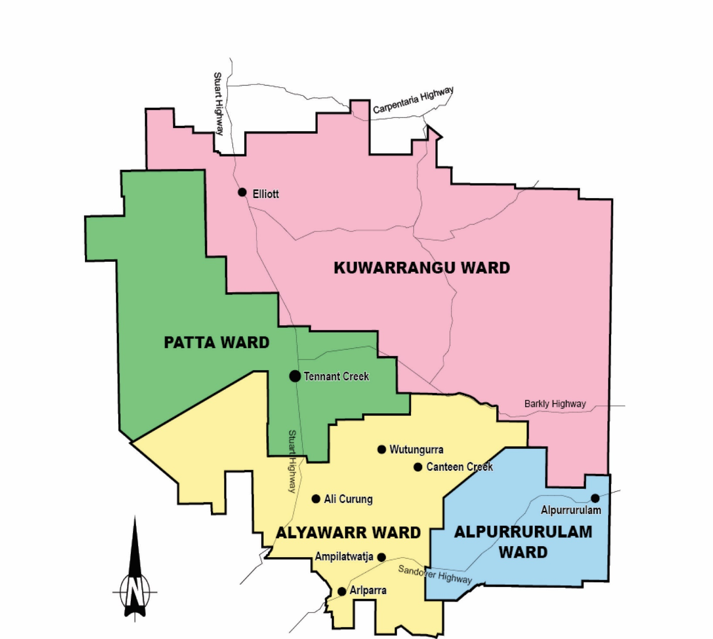
Barkly

Slide 11
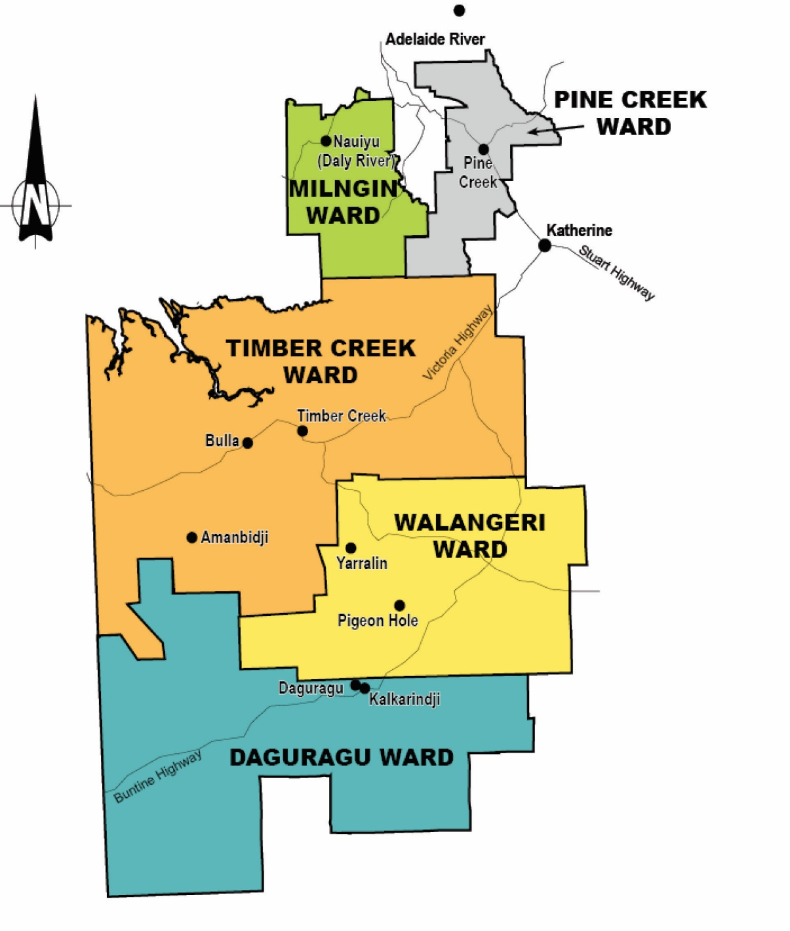
Victoria Daly

Slide 12
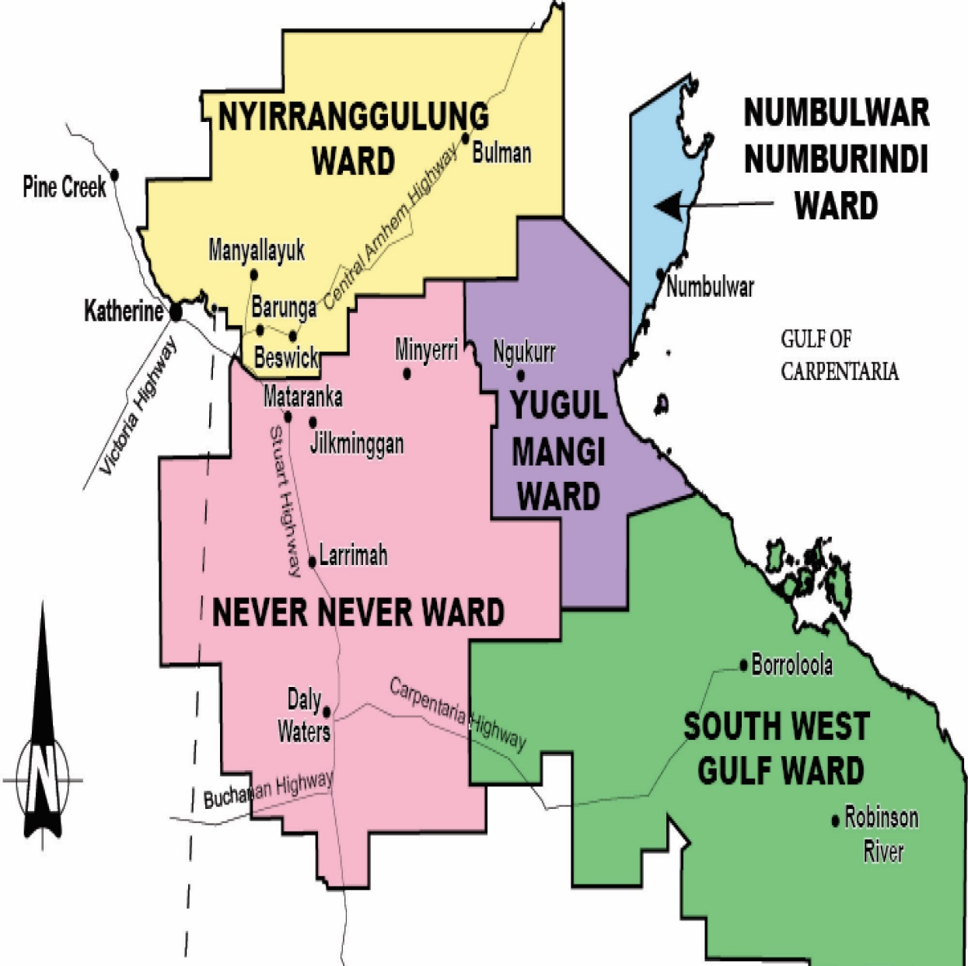
Roper Gulf

Slide 13
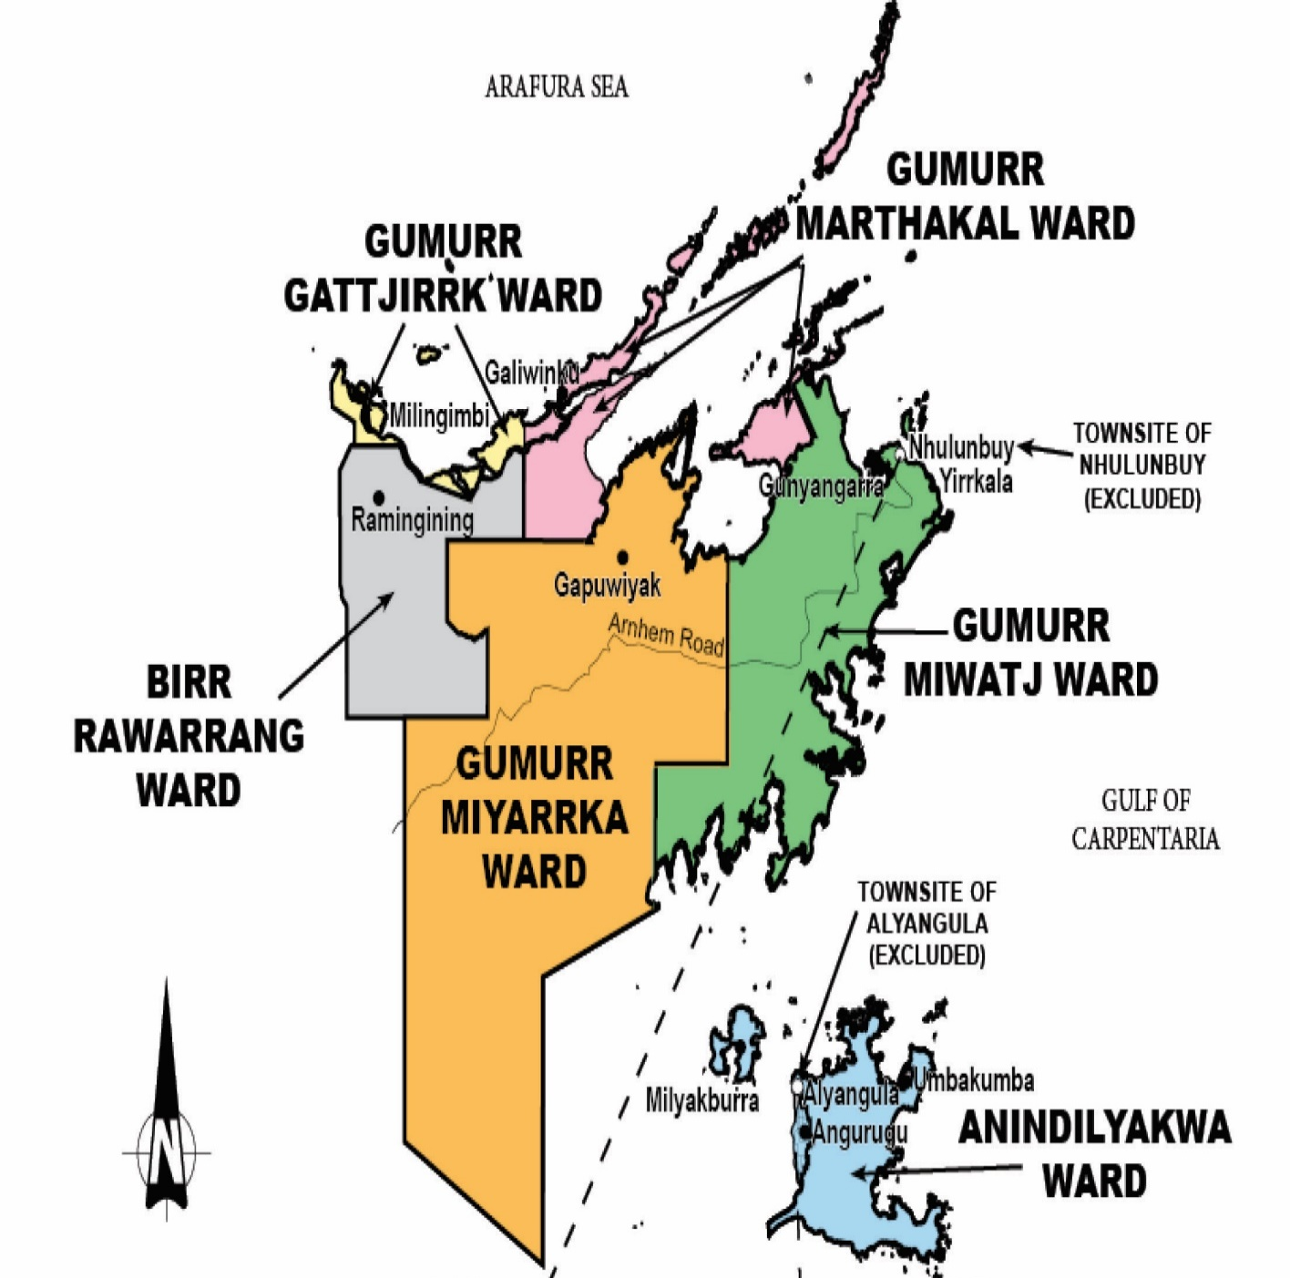
East
Arnhem

Slide 14
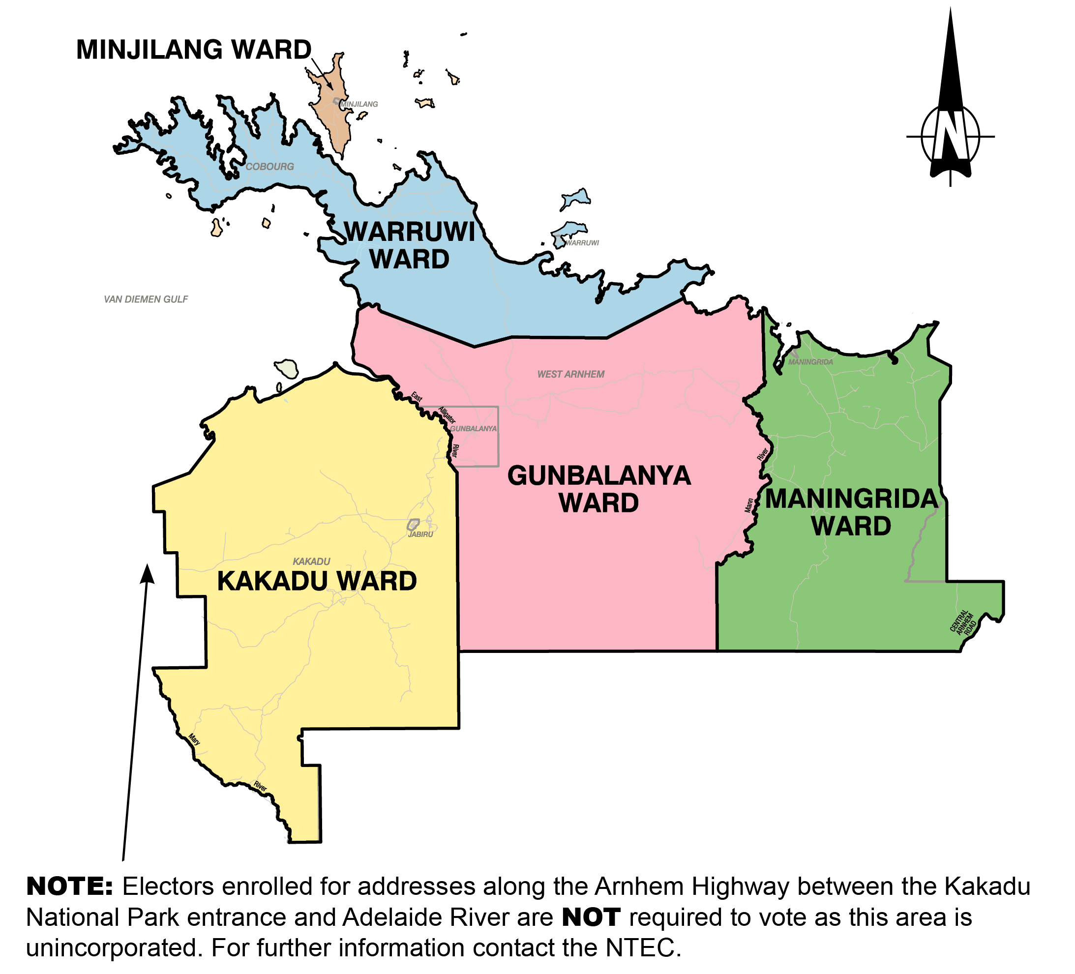
West Arnhem

Slide 15
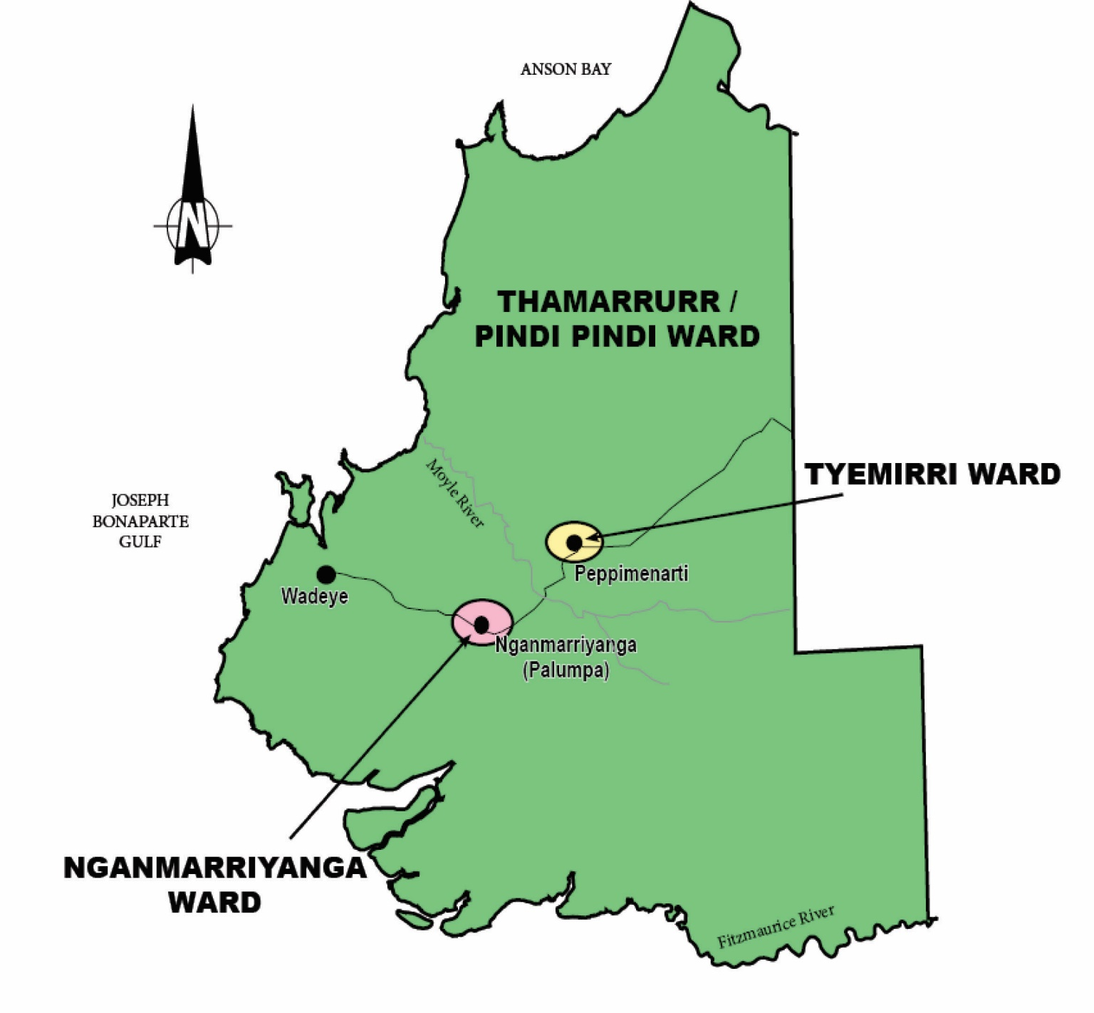
West Daly

Slide 16
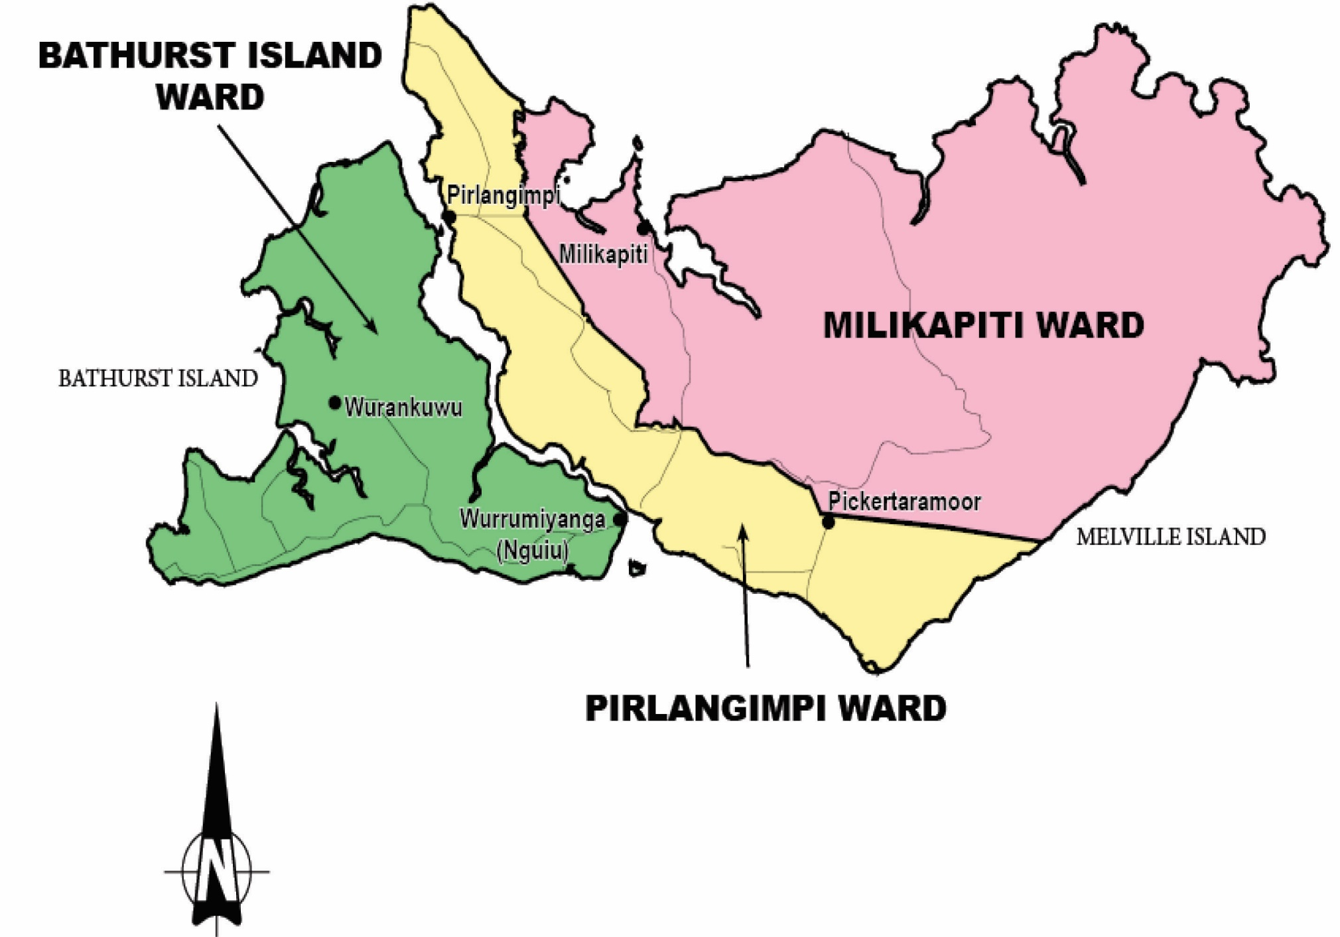
Tiwi Islands

Slide 17

Council Finances
Some councils in the Northern Territory do not receive high income from rates and need to rely on grant funding in order to provide services to their area.
The NT Government makes recommendations for the allocation of funding from the Commonwealth through the NT Grants Commission, which is the major source of funding for local government, and provides some additional funding programs itself.

Slide 18
Local Authority Project Funding
An amount is allocated to each regional council for Local Authority Projects to assist:
Building stronger communities and assist community priority projects as recommended by local authorities.
Local governing bodies and the constituent communities they represent to become stronger and self-sustaining.
Providing quality community infrastructure that facilitates community activity and integration.
Developing local government capacity to provide legitimate representation, effective governance, improved service delivery and sustainable development.

Slide 19

Meetings and Decision Making
Local Authorities meet at least 4 times a year.
A meeting has a “quorum” when there are enough members at the meeting to make decisions. A quorum for Local Authority meetings is the majority of members.
Local Authority decisions are made when a majority of members present at the meeting vote in favour.
Local Authority meetings are open to the public so that people in the community can see how Local Authority does its business and represents them.

Slide 20

Conflicts of Interest
A conflict of interest is when your duty as a Local Authority member conflicts with another interest that might mean you, a family member, close friend or business partner might get money, work or other personal benefits because of a Council decision.
If members have a personal or financial interest in a decision, they must disclose this interest at the council meeting and cannot participate in the decision.

Slide 21

Conflicts of Interest
If you have disclosed a conflict, you must remember to leave the meeting room before the decision is talked about or voted on.
If you do not properly manage conflicts of interest you may be in breach of the law.

Slide 22

Confidentiality
A member must respect the confidentiality of information obtained in their role as a Local Authority member.
A member must not misuse confidential information obtained in their role to gain a private benefit or to cause harm to another.
If the council considers confidential business at a meeting, the agenda for the meeting must identify the type of matter that is to be considered at the meeting.

Slide 23

Department of Chief Minister and Cabinet
Administers local government legislation.
Works with and supports local authorities and the local government sector.
Provides information, training, advice and assistance to local authorities and councils.
Makes sure that councils comply with the law and principles of good governance and management of council money.
Local authority members can bring concerns to the Department through LGQuestions.cmc@nt.gov.au or contact their local Department Community Development Officer
Notes:
The Local Government and Regional Development Unit administers the Local Government Act 2019 which I will talk briefly on in a moment. The Unit also administers other legislation including the Cemeteries Act 1952, Status of Darwin Act 1959 and Status of Palmerston Act 2000, which recognise the City of Darwin and City of Palmerston councils as cities.
The Unit also works with councils to bring positive change to communities and supports councils in carrying out their roles and responsibilities.
The Unit also provides information and supports community engagement through the development and administration of the BushTel website and the Remote Engagement and Coordination Strategy

Slide 24

Your local contact is:
Name, Regional Executive Director
for region

