Slide 1


Department of THE CHIEF MINISTER & CABINET
Understanding conflicts of interest
Local Authority Member course 2022/23

Slide 2

Course overview
What is a conflict of interest?
Understand when conflicts of interest happen.
How and when to disclose a conflict of interest
How to manage a conflict of interest and where to find support

Slide 3

What is a conflict of interest?
A conflict of interest is when you or someone close to you, or an organisation that you are involved in, might benefit from a decision due to your role as a local authority member.
The benefit could be money, work or other things.

Slide 4

1. What is a conflict of interest?
Someone close to you might include a family member or relative, roommate, friend, business partner or business relationship (like a company you regularly do business with).
If you have a conflict of interest it may effect your decision and others may think that the decision is biased.
Always ask if you're unsure.
.
Notes:
The Local Government Act is very strict about conflicts of interest. If a member declares a conflict of interest then they must leave the room straight away and not say anything.

Slide 5

1. What is a conflict of interest?
This can include:
  involvement in an organisation that deals with the council or does work for the council
  any benefits, concessions or discounts that you
  receive that may effect your work on the Local Authority
  gifts received that may influence your decision making
  interests in land,, housing, services or infrastructure
  that may be subject to council decisions

Slide 6

2. How do I identify a conflict of interest?
It is your responsibility to check through all of the agenda items before the meeting, and ask yourself if you have a conflict of interest.
It is important to speak up if you think you might have a conflict of interest.

Slide 7

2.1. Example of a conflict of interest
v
Bernie is an LA member. He also runs a gardening business. The council wants to employ someone to do mowing and maintenance of the oval and park in your community and asks for quotes for the work. Bernie submits a quote to do the job.
The LA is going to recommend to the council that work in the community should be conducted by local people if possible.
Bernie has a conflict of interest because his business might benefit from the recommendation to employ local people.
Bernie should leave the meeting when the LA is discussing the recommendation.
After the LA have made a decision, Bernie can return to the meeting. He must not make comments or ask questions about their decision, as the LA may not have agreed on the recommendation yet and have moved to the next agenda item. Bernie see what happened from the meeting minutes.

Slide 8

2.2. Example of Conflict of interest
v
Mary is an LA member. The council needs to decide which roads to improve this year and have asked the LA for their priorities. One of the roads to be considered is the road to Mary’s family’s outstation. Mary has a conflict of interest because the road would provide a benefit to her family.
However, if the road also serviced other outstations or other parts of the community then Mary does not have a conflict of interest because the road will also benefit the wider community and not just Mary’s family.

Slide 9

2.3. Example of conflict of interest
v
Angela is a member of the land council and the LA. The council are considering negotiating an agreement with the land council so that empty land in the LA area can be used for a park. The council has asked the LA for their recommendation.
Although everyone might think this is a good idea and would benefit the community, Angela has a conflict of interest and has to leave the room when the matter is being discussed at the LA because she might be seen as representing the land council in discussions.

Slide 10

3. Will others think it is a conflict of interest?
Sometimes, you might not have an actual conflict of interest, but other people may think it is (reasonably, of course).
This is called a ‘perceived conflict of interest’ and is just as significant as having an actual conflict of interest.
Notes:
These situations are difficult because it may not be an actual conflict of interest, however how people perceive the workings the council is important.
If someone is likely to complain you might need to think about whether you need to declare a conflict of interest

Slide 11
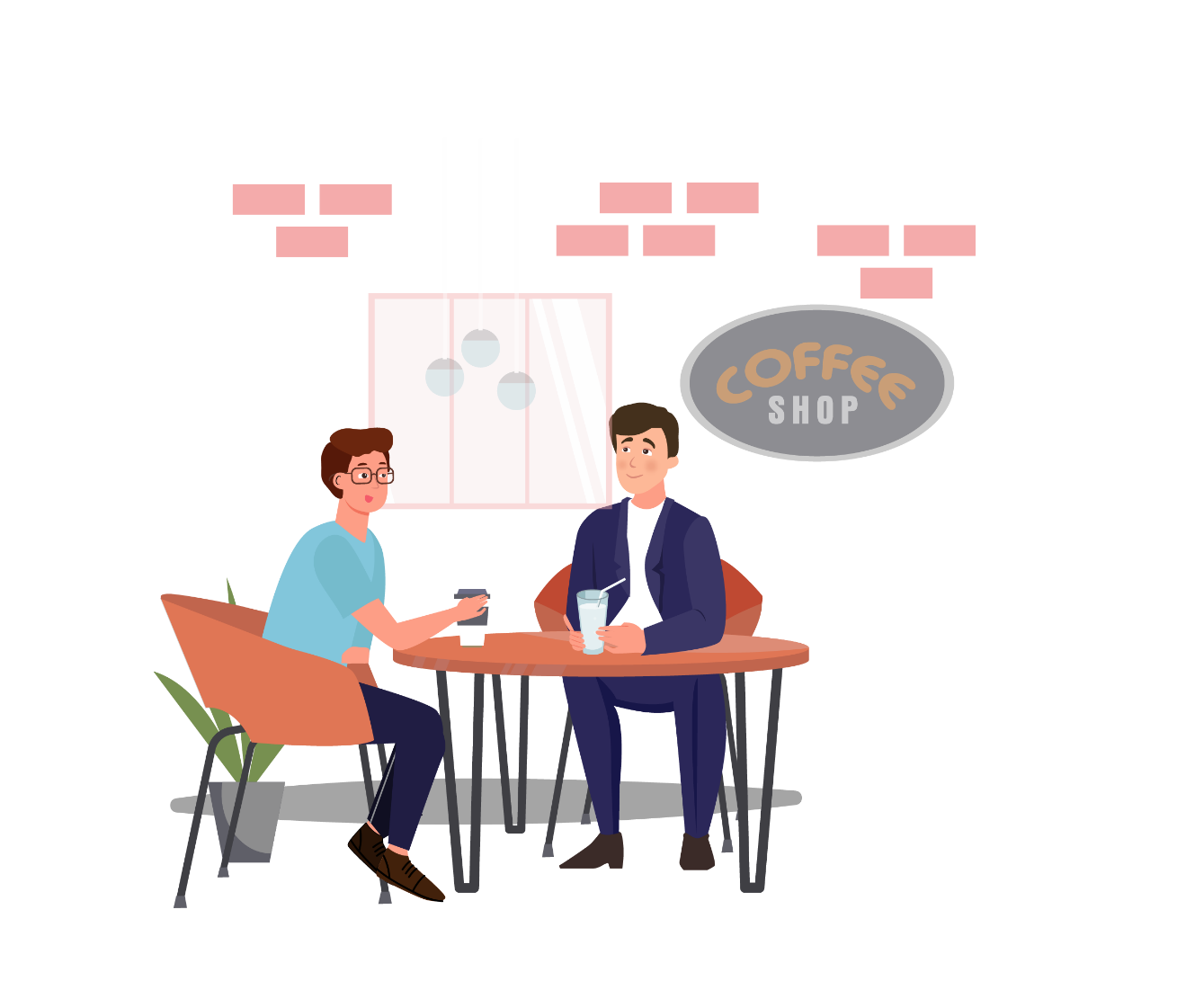
3. Perceived conflict of interest
For example, your cousin might be seeking a contract with council to provide skip bins and remove waste in your community.
You might not get any benefit, but people in the community might think that you potentially influenced the decision.
In this situation, it is always safest to declare a conflict of interest and leave the room when the Local Authority meeting is considering this item.

Slide 12

4. What should I do if I have a conflict of interest?
Don’t be embarrassed if you have a conflict of interest.
Local Authority members have good connections with the community, families who live in the area, and in surrounding communities, and are involved in sports clubs and other organisations, so conflicts of interest often arise.

Slide 13
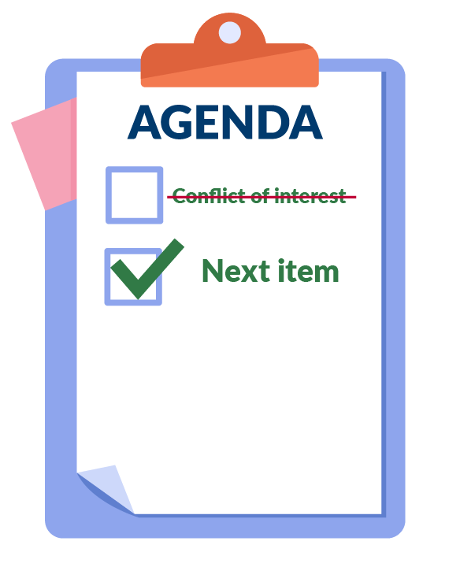
4. What should I do if I have a conflict of interest?
As soon as you become aware of a conflict you should declare it.
You can declare it before the meeting or at the start of a meeting.
If you don't realise you have a conflict until later in the
meeting, you need to declare as soon as you realise.
When the item comes up for discussion you must leave the room. When the discussion has finished, you may re-enter the room. Remember - you cannot take part in any decision making about that item.

Slide 14

5. What happens if I don’t disclose the conflict of interest?
Local Authority members have a duty to declare a conflict of interest.
Not disclosing a conflict of interest is an offence under the Local Government Act 2019.
It may also be improper conduct under the Independent Commissioner Against Corruption Act.
If you do not disclose a conflict of interest or do not leave the meeting room, any decisions made by council on the LA recommendation can be questioned by a court and overturned or cancelled.

Slide 15

5. What happens if I don’t disclose the conflict of interest?
I have a conflict of interest
Your reputation in the community may be damaged if you are seen to be getting benefits for yourself, your family, friends or business partners because of your role as a LA member.
It is always safest to declare a conflict of interest and to not participate in the LA’s discussion or decision.
This will help to ensure that LA recommendations are made in the best interests of the whole community.

Slide 16

6. When it’s not a conflict of interest
In some circumstances you do not have a conflict of interest if the interest is shared with other people in the community.
For example, the LA might recommend to council that the community footy oval is upgraded, or to put in new street lighting.
While you might get a benefit, these situations are not conflicts of interest, as the interest is shared with others in the community.

Slide 17

7. Who can I talk to?
If you are unsure about whether you have a conflict of interest, you can talk with your Chair or the CEO.
If you think another member has a conflict of interest you should talk to the Chair.
It’s important to ask questions and speak up so you know your responsibilities as a LA member.
Notes:
You could ask your CSM to refer it to the CEO or talk to someone in the Department.

