Slide 1


Department of THE CHIEF MINISTER & CABINET
Roles and Responsibilities of Local Authority Members

Slide 2

Course overview
The role of a local authority member
How are local authorities formed?
What is the business of the local authority
What is the business of council
Responsibilities of local authority members
Engaging your community
Local Authority Project Funding

Slide 3

1. What is the role of a local authority member?
  A local authority member is the voice of people in their community. Their role includes:
  Supporting your community to have a say in council business.
  Providing recommendations to the council.
  Let the community know what the council is doing.

Slide 4

2. How are local authorities formed?
It is the Minister for Local Government that picks the local authorities for your regional council.
The council creates the local authority and the area it covers.
The council will decide on the number of members for the local authority.
  6 is the minimum number and 14 is the maximum.
The local authority includes at least one council member from the local authority’s ward.

Slide 5
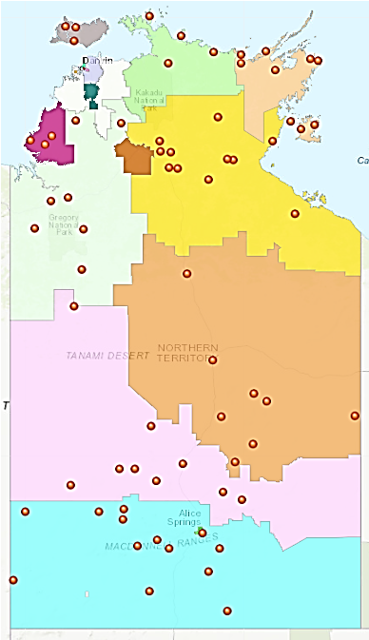
Where are the Local Authorities?
There are currently 67 Local Authorities
Local Authorities are connected
with the following regional councils:
Barkly
Central Desert
East Arnhem
MacDonnell
Roper Gulf
Tiwi
Victoria Daly
West Arnhem
West Daly
Notes:
Insert slide after this one giving map of local authorities for relevant region.

Slide 6

3. What is the business of a local authority?
Local authorities work with their communities and their council on local issues and priorities.
The Local Authority provides advice to the council on:
  budget
  priorities for expenditure
  service delivery
  regional plans
  strategic directions
  funding

Slide 7

4. What is the business of council?
The business of a council in the Northern Territory includes making decisions on services and infrastructure to the council area such as:
waste collection
roads
street lighting
libraries
parks and gardens
community events
Regional councils also often deliver services such as aged care, disability services, youth programs and early childhood/child care. They help plan and deliver community projects that have been identified as priorities by each local authority.

Slide 8

5. What are the responsibilities of local authority members?
Local Authority members:
Attend meetings (meetings must be held at least 4 times a year)
Make recommendations to council about issues in their area
Provide recommendations to council about Local Authority Project Funding
Exercise any delegated powers from the council
Comply with the code of conduct
Act in the best interests of your area
Declare any conflicts of interest
Notes:
You may be able to attend by phone or video if the council policy allows it.
Delegated powers – if you request it the council may decide to give a LA some of the decision-making that would usually just be for council

Slide 9
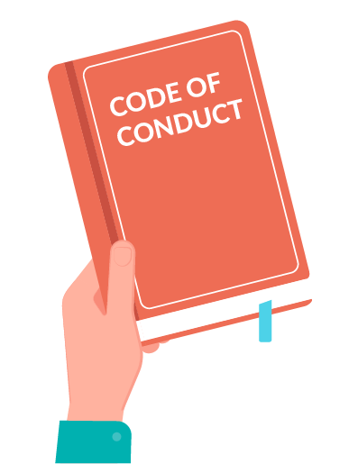
Code of Conduct
The Code of Conduct outlines the expected behaviour of council and local authority members.
The Code of Conduct requires members to:
  Act with honesty and integrity; care and diligence; and courtesy
  Be respectful to each other and council staff; of culture and diversity; and of confidential information shared with them.
  Declare conflicts of interest and gifts that may influence their decision
  Be accountable to the community and act in the interests of all
  Take part in training where required.

Slide 10

5. What is the role of the Chair?
The Chair is appointed by the Local Authority members.
They have the same roles and responsibilities as other local authority members, but they also have some extra roles. These include:
Chairing meetings of the local authority
Running a good meeting, keeping everyone on track and respectful.
Making sure all voices are heard and the local authority is making good recommendations to the council.

Slide 11
6. How can I perform my role well?
You should know what is going on in your community.
Talk to the community about their concerns and what they would like council to do for them and provide this feedback to council.
Think about the information and the options and what the community needs.
It is important to ask questions about things that are not clear and seek more information.
COUNCIL
LA
COMMUNITY
LA
Notes:
Like a loop - LA members take the views of local communities to council and act as a voice on their behalf and then they take council information and decisions back to community so they are aware of what’s happening to the things that they have raised.

Slide 12

7. Local Authority Project Funding
Each local authority has a bucket of money to assist with local projects.
You should talk to your community about what is needed and make recommendations for how this money should be used. e.g playgrounds or street lighting.
You might also want to use the money to support the local authority and local councillors to understand their roles and how to achieve the best outcomes for the community.
Notes:
This could be for improving infrastructure like the playground or street lighting. Or it could be for services in your community like a child care centre. Or for a project like recycling waste.

Slide 13

Resources
For more information, view the following resources:
The Local Government Act 2019 at Part 7.2 talks about declaring interests, conflict of interests, and gifts and benefits.
The Code of Conduct is contained at Schedule 1 to the Act also covers the areas in this module.
The Local Authority Project Guidelines can be found here:
https://cmc.nt.gov.au/__data/assets/pdf_file/0010/595585/local-authority-project-funding-guidelines.pdf

