Slide 1


Living Strong Program
Territory Families, Housing
and Communities

Slide 2
We respectfully acknowledge the Traditional Owners of this country.
We recognise their continuing connection to the land we are on today, their waters and their culture.
We pay our respect to their
Elders past, present and emerging.

Slide 3

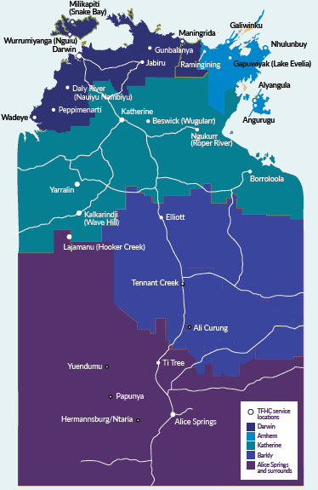
What is Living Strong?
The Living Strong Program is a tenancy management support service designed to increase the knowledge and skills of tenants to maintain a safe and healthy home and to create a thriving living environment across our communities.
It focuses on helping people learn and develop “hands-on” living skills (skills that support people living independently).
After completing the program our clients should have greater confidence and control of their housing and understand that looking after your house and yard is an important part of looking after your family’s health.

Slide 4

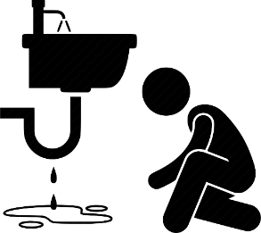


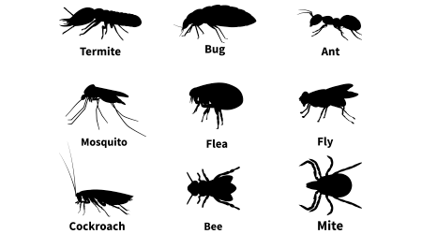
The Living Strong Program Sessions
I’m having a lot of problems with my visitors, what can I do?
?
Understanding your tenancy & managing visitors
Repairs and maintenance
Looking after your yard, pets and pest control
Managing money
Keeping your home safe, working and healthy
What does it mean to be a tenant?
How does having a clean house help keep my family healthy?
What problems do I need to report?
How do I keep my house clean?
How do I report repairs?
What does housing use my rent for? Why do I need to pay it?
I think my dog is sick? Who do I talk to? How did they get sick?
What do I do to get rid of my debt? Who can help me?
Where are all these bugs coming from?
What are they?
Can they make me sick?

Slide 5

Living Strong Program principles
Session delivery is engaging
Cultural Appropriateness
For example, session materials should be in plain English or local language where possible
For example, sessions should include practical demonstrations where possible.
Attendance is not compulsory, however all responsible household members should participate in and complete the program.
Recognising that different households will have varying levels of past experience and knowledge of the subjects covered by the program.
Delivery based
on the needs of
each household

Slide 6

Planning and delivering Living Strong
Things to consider:
What are the common local languages? Is it better to have sessions in Aboriginal language? Or is English okay?
Are there any cultural sensitivities with presenting sessions?
What resources already exist and what needs to be created?
Where will sessions be delivered?
Is there a relevant organisation who could help deliver this content?

Slide 7


Session 1 – Tenancy Agreements & Visitors
Understanding your tenancy
What will be covered:
What is a tenancy agreement?
What are the roles and responsibilities of a tenant and a landlord?
How it could be delivered:
Ask tenants who remembers signing a Tenancy Agreement? What did they know about it?
Can they list any rights and responsibilities under the Agreement? Explore this
Explain the changes to visitor requirements. What has worked for people in managing visitors?
Conduct a quiz to review the material covered in the session.
Visitor Management
What will be covered:
Tenants can have visitors come and stay.
If they stay longer than 14 days you need to let Housing know.
Visitors have to follow the same rules as tenants.

Slide 8

Session 2 – Preventative Repairs & Maintenance
Preventative repairs
What will be covered:
The remote housing maintenance service will visit every house in the next few months to see what need to be fixed.
This will happen yearly from now on.
This will happen so that housing can check for any issues with the house and fix them before they get worse, or make a plan for bigger jobs.
How it will be delivered:
Invite the Remote Housing Maintenance team to come along and explain the surveys they will do.
Go through the sorts of things that tenants should be reporting to get fixed. Provide resources on how to report maintenance, what to look for and how to describe various issues.
Demonstrate and teach some basic repairs that tenants can complete themselves.
Maintenance
What will be covered:
Tenants need to let Housing know if their house needs repairs. Fixing broken things early can stop bigger problems from happening. It can also be cheaper which means more money for new houses or bigger jobs (like a new roof).
Housing will organise someone to fix damaged or broken items.
Tenants can be taught some basic repairs they can do themselves.

Slide 9


Session 3 – Looking after your house
Looking after your kitchen
Looking after your bathroom, laundry and toilet
What will be covered:
What are the department looking for when they do a housing inspection? What can you do to prepare?
How do I clean my kitchen? What do I clean with? How often should I clean things?
What do I do if something is broken or I think something might be broken?
What are common maintenance issues to look out for?
What will be covered:
How a clean and functioning bathroom, laundry and toilet helps your family’s health
How to effectively clean bathroom, laundry and toilets. What tools/products can be used? How often these areas should be cleaned?
What do I do if something is broken or I think something might be broken?
What are common maintenance issues to look out for?
How it will be delivered:
Undertake a mock inspection of a house, looking at all the things a tenancy office will look at in an inspection. Also note things that should be reported for repair and what to look for.
Focus on what needs to be cleaned, how to clean and what you would use. Focus on why this is important to the health of the family.
Go through some options for cleaning solutions.
You could include someone from the clinic to focus on the importance of a healthy home.

Slide 10


Session 4 – Rent and managing your money
Rent
What will be covered:
You must pay rent for your house.
The amount of rent you pay will be changing soon (September). From September 2022, you will be charged rent based on how big your house is ($70 per room).
Housing will talk with you more before this change happens.
If you can’t pay your rent talk to Housing as soon as possible – or else you will get a debt.
Housing will help you set up deductions for your rent to be paid automatically.
How it will be delivered:
Present information relating to rent including changes to the rent model which will happen in September 2022.
Ask tenants to list of essential things that money is needed for. Ask them to divide them into things that are most important and less important.
Discuss ideas for saving money.
Link people with assistance if they are having money problems.
Managing your Money
What will be covered:
Household costs should be shared between everyone living in a house.
What is money needed for? What are essential items and what are ‘extra or nice to have’ items?
There are different ways to save money.

Slide 11



Session 5 – Yard, pets and pest control
Looking after your yard, pets and pest control
Yard:
Keep your yard clean and tidy so that it is safe for your family.
Keep the grass short.
Clean up the rubbish.
Pets:
A healthy pet can help keep your family healthy.
Let Housing know how many pets you have and if you are getting a new pet.
Make sure your pet doesn’t cause trouble for people.
Pest control:
Bugs, ants and pests can carry disease.
Keep your food in containers that seal. Keep surfaces clean of leftover/old food.
Try to not get any holes in the flyscreen and get your flyscreen fixed if it’s broken. Use cockroach baits, and if you have too many pests talk to Housing.
How it will be delivered:
What are the things you need to think about in your yard?
Go through the yard and talk about how to keep the yard safe and tidy.
Cover tips for preventing pests, what to do if you have pests, and when you should report it to Housing.
Discuss tenants responsibility to look after pets and keep them healthy, and how this can help keep the family healthy.

Slide 12
Planning and delivering Living Strong
Tenancy providers are required to develop a plan of how they intend to deliver the Living Strong program to all households within their contracted region. This will be discussed with the contract manager.
The program may include practical demonstrations, interactive workshops, linking with other community activities. Creativity is encouraged!
You may want to deliver sessions to large groups, or use a house by house approach.
You are encouraged to link with other services to plan and present your sessions, for example:
  local health clinics – To reinforce and assist with messaging around healthy living and cleanliness, pet health etc.
  maintenance contractors – To assist with sessions on repairs and maintenance.
  Other NGOs – as necessary

Slide 13
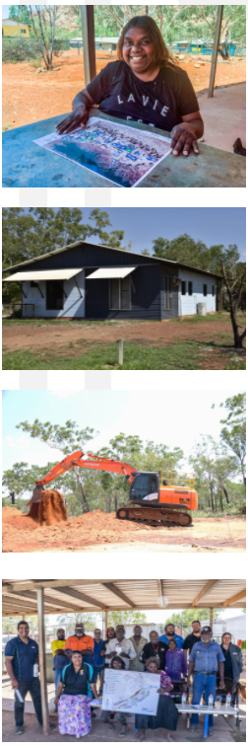
Living Strong Program support
Tenancy Support providers are encourage to create their own session ideas and resources. These may be shared with other providers.
A website portal has been developed to collect all of the resources, program information and learnings for the program in one place. It will be updated regularly.
Service providers and contract managers are encouraged to submit ideas and resources for inclusion on the site!
Access the website here

